Slide 1
Associative Memory Networks
By
Varun Deshmukh
Assistant Professor,
Department of Computer Engineering,
MPSTME, Shirpur Campus

Slide 2
Introduction
An associative memory network can store a set of patterns as memories. When the associative memory is being presented with a key pattern, it responds by producing one of the scored patterns, which closely resembles or relates to the key pattern.
Thus, the recall is through association of the key pattern, with the help of information memorized.
These types of memories are also called as content-addressable memories (CAM) in contrast to that of traditional address-addressable memories in digital computers where stored pattern (in bytes) is recalled by its address.
It is also a matrix memory as in RAM/ROM. The CAM can also be viewed as associating data to address, i.e. for every data in the memory there is a corresponding unique address.
Also, it can be viewed as data correlator. Here input data is correlated with that of the stored data in the CAM.
It should be noted that stored patterns must be unique, i.e., different patterns in each location. If the same pattern exists in more than one location in the CAM, then, even though the correlation is correct, the address is noted to be ambiguous. The basic structure of CAM is given in Figure.

Slide 3
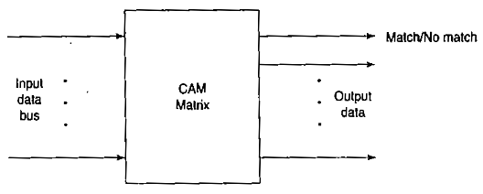
Introduction
Associative memory makes a parallel search within a stored data file. The concept behind this search is to Output any one or all Stored items which match the given search argument and to retrieve the stored data either completely or partially.
Two types of associative memories can be differentiated. They are auto-associative memory and hetero-associative memory. Both these nets are single layer nets in which the weights are determined in a manner that the net stores a set of pattern associations.
Each of this association is an input-output vector pair, say, s:t.
If each of the output vectors is same as the input vectors with which it is associated, then the net is said to be auto-associative memory net. On the other hand, if the output vectors are different from the input vectors then the net is a said to be hetero-associative memory net.

Slide 4
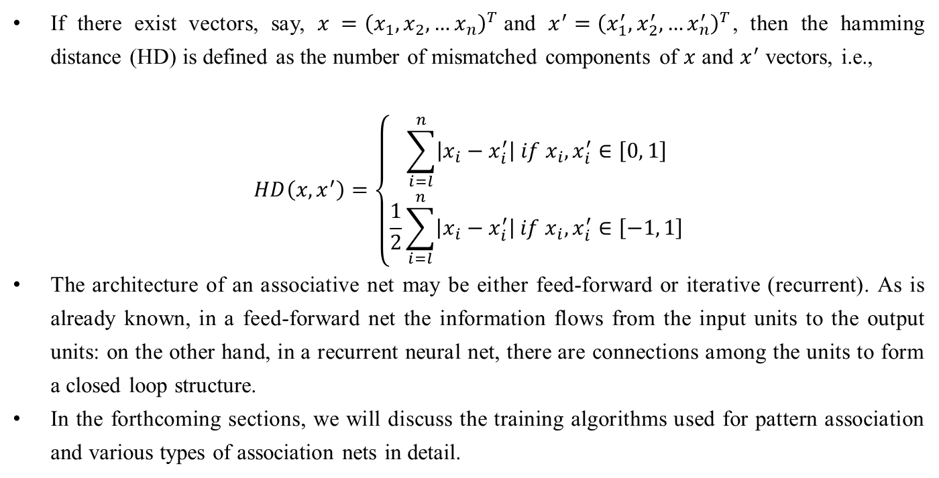
Introduction
If there exist vectors, say, $x ={\left(x_{1},x_{2},…x_{n}\right)}^{T}$and $x^{′}={\left(x_{1}^{′},x_{2}^{′},…x_{n}^{′}\right)}^{T}$, then the hamming distance (HD) is defined as the number of mismatched components of $x$ and $x^{′}$ vectors, i.e.,
$$HD\left(x, x^{′}\right)=\left\{\begin{matrix}\sum_{i=l}^{n}{\left|x_{i}−x_{i}^{′}\right| if x_{i},x_{i}^{′}∈\left[0, 1\right]} \\ \frac{1}{2}\sum_{i=l}^{n}{\left|x_{i}−x_{i}^{′}\right| if x_{i},x_{i}^{′}∈\left[−1, 1\right]}\end{matrix}\right.$$
The architecture of an associative net may be either feed-forward or iterative (recurrent). As is already known, in a feed-forward net the information flows from the input units to the output units: on the other hand, in a recurrent neural net, there are connections among the units to form a closed loop structure.
In the forthcoming sections, we will discuss the training algorithms used for pattern association and various types of association nets in detail.

Slide 5
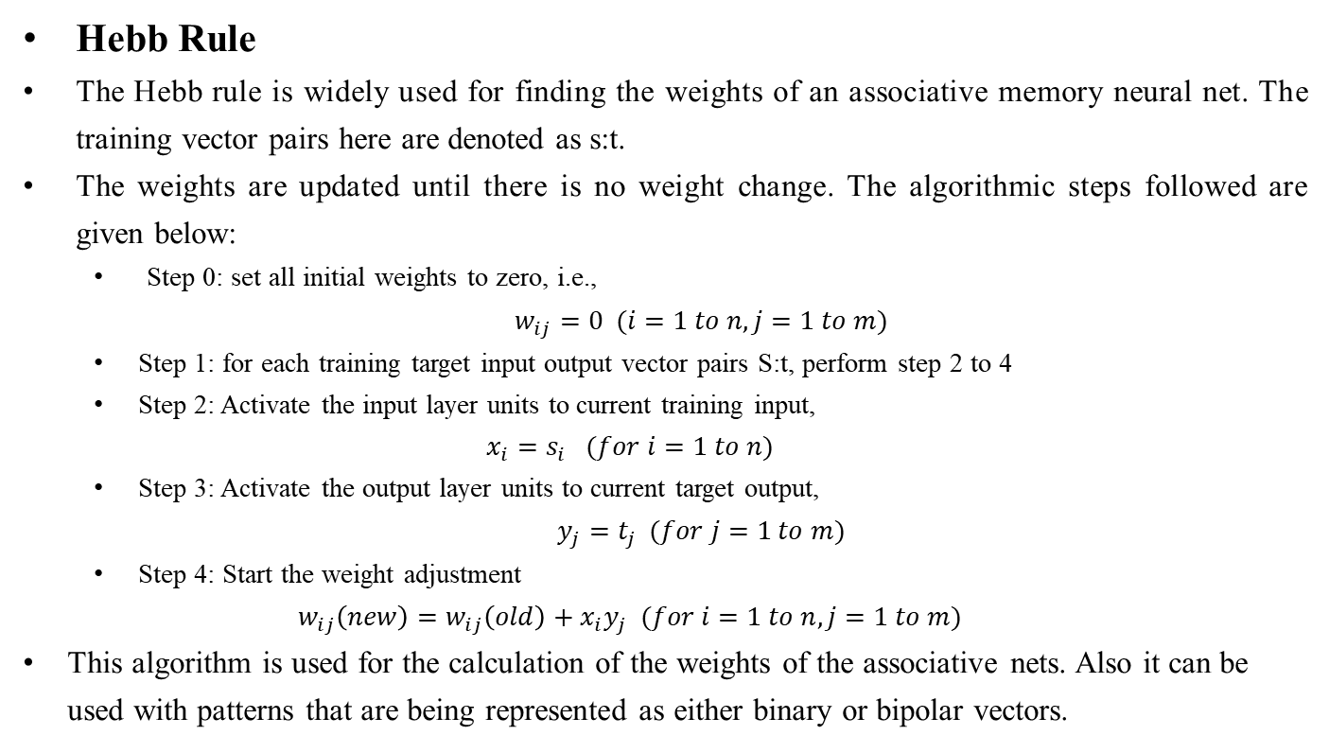
Training Algorithm for Pattern Association
Hebb Rule
The Hebb rule is widely used for finding the weights of an associative memory neural net. The training vector pairs here are denoted as s:t.
The weights are updated until there is no weight change. The algorithmic steps followed are given below:
Step 0: set all initial weights to zero, i.e.,
$w_{ij}=0 (i=1 to n, j=1 to m)$
Step 1: for each training target input output vector pairs S:t, perform step 2 to 4
Step 2: Activate the input layer units to current training input,
$$x_{i}=s_{i} (for i=1 to n)$$
Step 3: Activate the output layer units to current target output,
$y_{j}=t_{j} (for j=1 to m)$
Step 4: Start the weight adjustment
$$w_{ij}\left(new\right)=w_{ij}\left(old\right)+x_{i}y_{j} (for i=1 to n, j=1 to m)$$
This algorithm is used for the calculation of the weights of the associative nets. Also it can be used with patterns that are being represented as either binary or bipolar vectors.

Slide 6
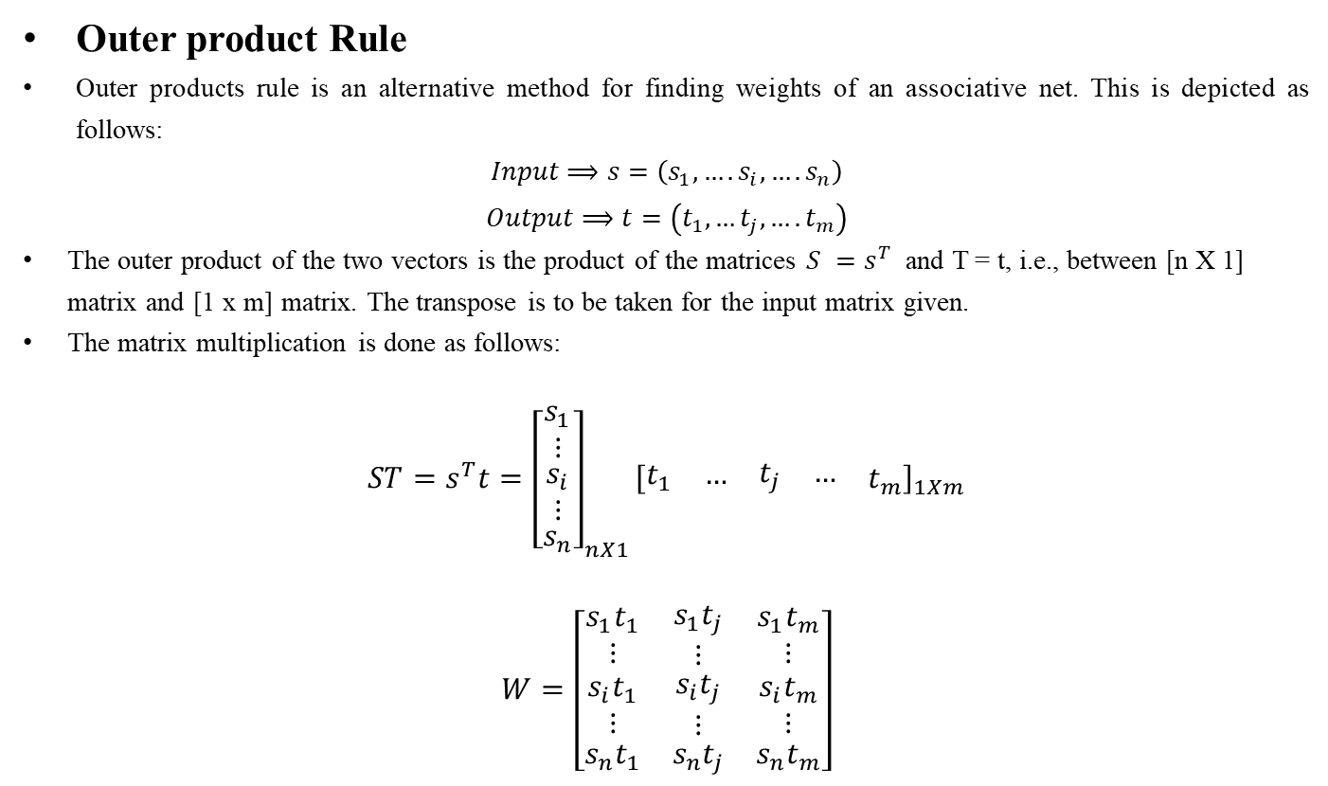
Training Algorithm for Pattern Association
Outer product Rule
Outer products rule is an alternative method for finding weights of an associative net. This is depicted as follows:
$$Input⟹s=\left(s_{1},….s_{i},….s_{n}\right)$$
$Output⟹t=\left(t_{1},…t_{j},….t_{m}\right)$
The outer product of the two vectors is the product of the matrices $S =s^{T}$ and T = t, i.e., between [n X 1] matrix and [1 x m] matrix. The transpose is to be taken for the input matrix given.
The matrix multiplication is done as follows:
$$ST=s^{T}t={\left[\begin{matrix}\begin{matrix}s_{1} \\ ⋮\end{matrix} \\ \begin{matrix}s_{i} \\ ⋮\end{matrix} \\ s_{n}\end{matrix}\right]}_{nX1}{\left[\begin{matrix}\begin{matrix}t_{1} & …\end{matrix} & \begin{matrix}t_{j} & …\end{matrix} & t_{m}\end{matrix}\right]}_{1Xm}$$
$$W=\left[\begin{matrix}\begin{aligned}s_{1}t_{1} \\ ⋮\end{aligned} & \begin{aligned}s_{1}t_{j} \\ ⋮\end{aligned} & \begin{aligned}s_{1}t_{m} \\ ⋮\end{aligned} \\ \begin{aligned}s_{i}t_{1} \\ ⋮\end{aligned} & \begin{aligned}s_{i}t_{j} \\ ⋮\end{aligned} & \begin{aligned}s_{i}t_{m} \\ ⋮\end{aligned} \\ s_{n}t_{1} & s_{n}t_{j} & s_{n}t_{m}\end{matrix}\right]$$

Slide 7
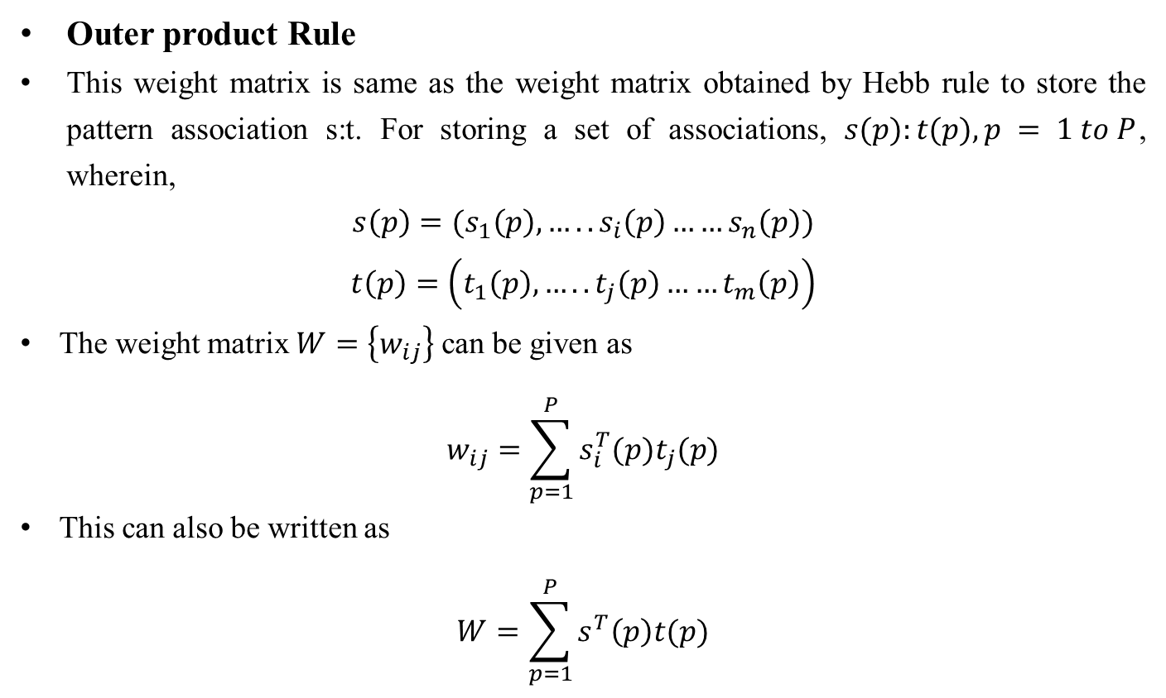
Training Algorithm for Pattern Association
Outer product Rule
This weight matrix is same as the weight matrix obtained by Hebb rule to store the pattern association s:t. For storing a set of associations, $s(p):t(p), p = 1 to P$, wherein,
$$s\left(p\right)=(s_{1}\left(p\right),…..s_{i}\left(p\right)……s_{n}\left(p\right))$$
$$t\left(p\right)=\left(t_{1}\left(p\right),…..t_{j}\left(p\right)……t_{m}\left(p\right)\right)$$
The weight matrix $W=\left\{w_{ij}\right\}$ can be given as
$$w_{ij}=\sum_{p=1}^{P}{s_{i}^{T}(p)t_{j}(p)}$$
This can also be written as
$$W=\sum_{p=1}^{P}{s^{T}\left(p\right)t(p)}$$

Slide 8
Auto-associative Memory Network
Theory
In the case of an auto-associative neural net, the training input and the target output vectors are the same.
The-determination of weights of the association net is called storing of vectors. This type of memory net needs suppression of the output noise at the memory output.
The vectors that have been stored can be retrieved from distorted (noisy) input if the input is sufficiently similar to it.
The net's performance is based on its ability to reproduce a stored pattern from a noisy input.
It should be noted, that in the case of auto-associative net, the weights on the diagonal can be set to zero. This can be called as auto associative net with no self connection.
The main reason behind setting the weights to zero is that it improves the net's ability to generalize or increase the biological plausibility of the net. This may be more suited for iterative nets and when delta rule is being used.

Slide 9
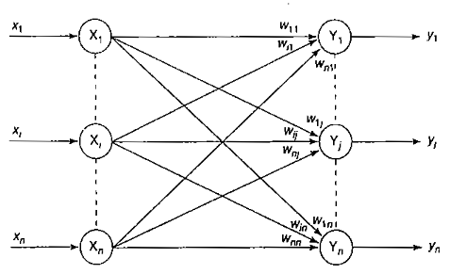
Auto-associative Memory Network
Architecture
The architecture of an auto-associative neural net is shown in Figure. It shows that for an auto-associative net, the training input and target output vectors are the same.
The input layer consists of n input units and the output layer also consists of n output units.
The input and output layers are connected through weighted interconnections.
The input and output vectors are preferably correlated with each other component by component.

Slide 10
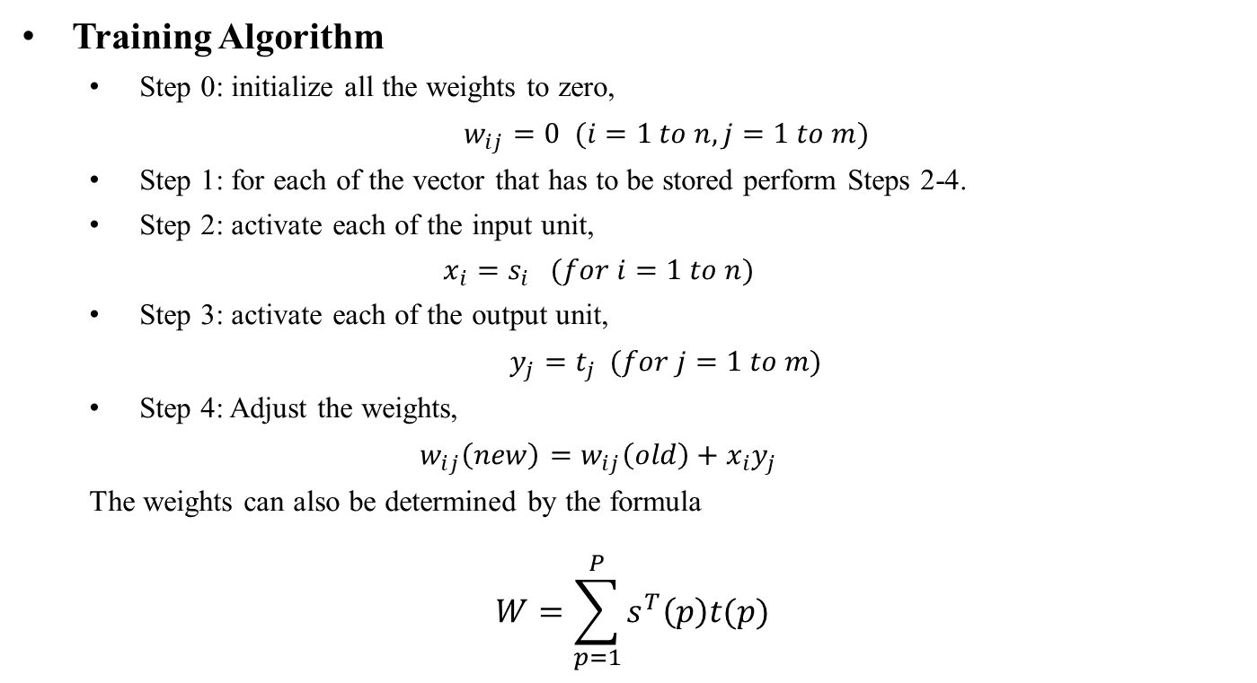
Auto-associative Memory Network
Training Algorithm
Step 0: initialize all the weights to zero,
$w_{ij}=0 (i=1 to n, j=1 to m)$
Step 1: for each of the vector that has to be stored perform Steps 2-4.
Step 2: activate each of the input unit,
$$x_{i}=s_{i} (for i=1 to n)$$
Step 3: activate each of the output unit,
$y_{j}=t_{j} (for j=1 to m)$
Step 4: Adjust the weights,
$$w_{ij}\left(new\right)=w_{ij}\left(old\right)+x_{i}y_{j}$$
The weights can also be determined by the formula
$$W=\sum_{p=1}^{P}{s^{T}\left(p\right)t(p)}$$

Slide 11
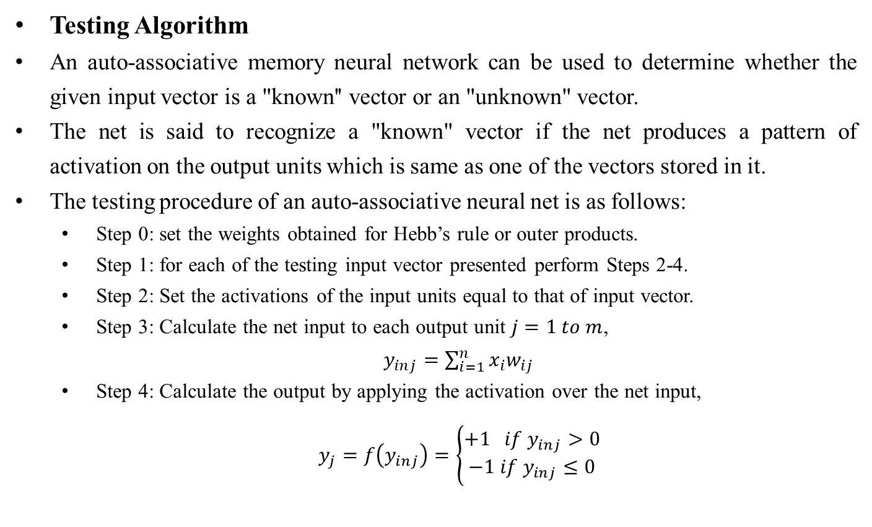
Auto-associative Memory Network
Testing Algorithm
An auto-associative memory neural network can be used to determine whether the given input vector is a "known'' vector or an "unknown" vector.
The net is said to recognize a "known" vector if the net produces a pattern of activation on the output units which is same as one of the vectors stored in it.
The testing procedure of an auto-associative neural net is as follows:
Step 0: set the weights obtained for Hebb’s rule or outer products.
Step 1: for each of the testing input vector presented perform Steps 2-4.
Step 2: Set the activations of the input units equal to that of input vector.
Step 3: Calculate the net input to each output unit $j=1 to m$,
$y_{inj}=\sum_{i=1}^{n}{x_{i}w_{ij}}$
Step 4: Calculate the output by applying the activation over the net input,
$y_{j}=f\left(y_{inj}\right)=\left\{\begin{aligned}+1 if y_{inj}>0 \\ −1 if y_{inj}≤0\end{aligned}\right.$

Slide 14
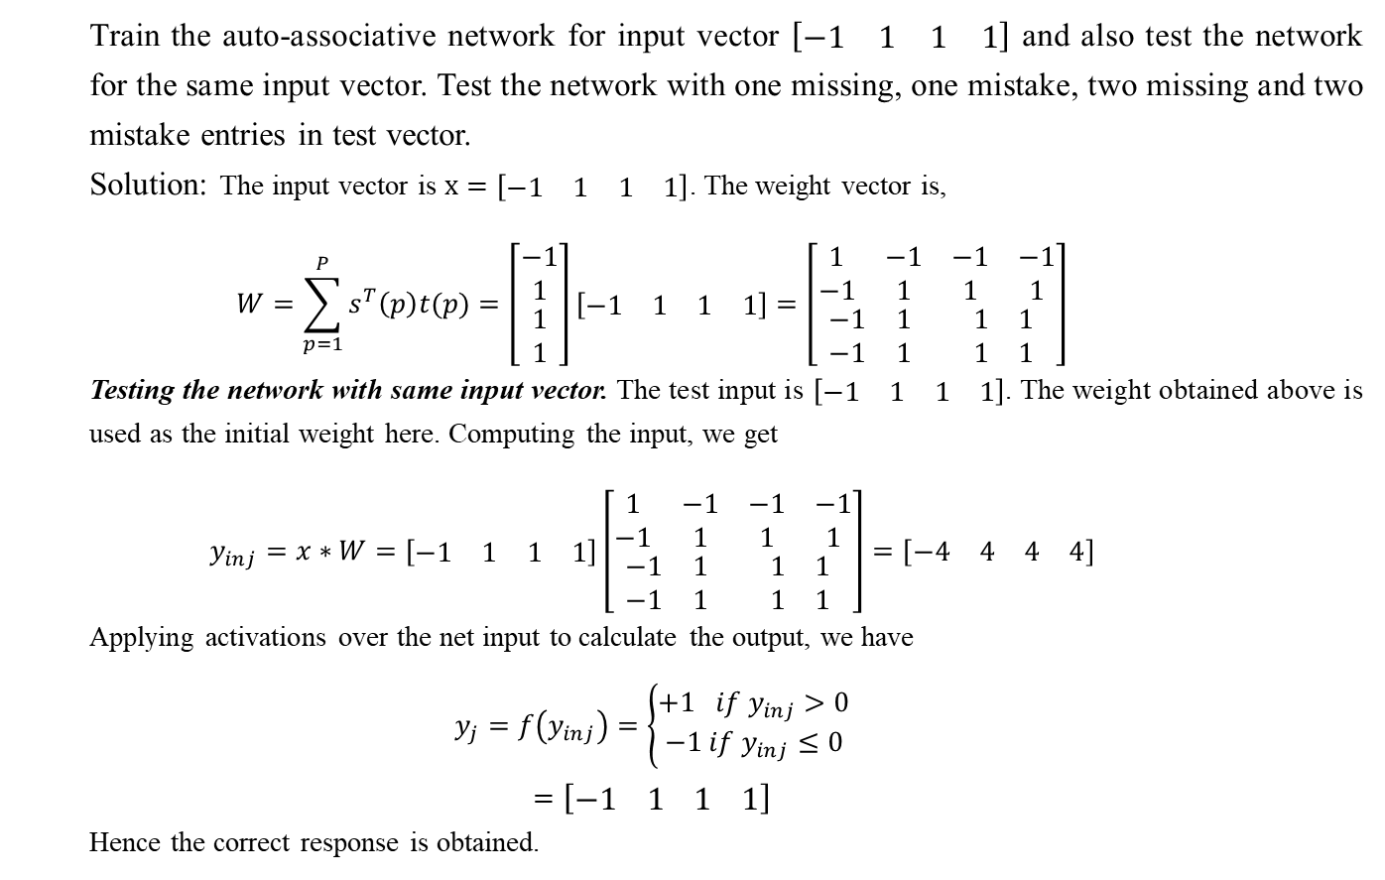
Auto-associative Memory Network
Train the auto-associative network for input vector $\left[\begin{matrix}\begin{matrix}−1 & 1\end{matrix} & \begin{matrix}1 & 1\end{matrix}\end{matrix}\right]$ and also test the network for the same input vector. Test the network with one missing, one mistake, two missing and two mistake entries in test vector.
Solution: The input vector is $x=\left[\begin{matrix}\begin{matrix}−1 & 1\end{matrix} & \begin{matrix}1 & 1\end{matrix}\end{matrix}\right]$. The weight vector is,
$$W=\sum_{p=1}^{P}{s^{T}\left(p\right)t(p)}=\left[\begin{matrix}\begin{matrix}−1 \\ 1\end{matrix} \\ \begin{matrix}1 \\ 1\end{matrix}\end{matrix}\right]\left[\begin{matrix}\begin{matrix}−1 & 1\end{matrix} & \begin{matrix}1 & 1\end{matrix}\end{matrix}\right]=\left[\begin{matrix}\begin{matrix}1 & −1 \\ −1 & 1\end{matrix} & \begin{matrix}−1 & −1 \\ 1 & 1\end{matrix} \\ \begin{matrix}−1 & 1 \\ −1 & 1\end{matrix} & \begin{matrix}1 & 1 \\ 1 & 1\end{matrix}\end{matrix}\right]$$
Testing the network with same input vector. The test input is $\left[\begin{matrix}\begin{matrix}−1 & 1\end{matrix} & \begin{matrix}1 & 1\end{matrix}\end{matrix}\right]$. The weight obtained above is used as the initial weight here. Computing the input, we get
$$y_{inj}=x∗W=\left[\begin{matrix}\begin{matrix}−1 & 1\end{matrix} & \begin{matrix}1 & 1\end{matrix}\end{matrix}\right]\left[\begin{matrix}\begin{matrix}1 & −1 \\ −1 & 1\end{matrix} & \begin{matrix}−1 & −1 \\ 1 & 1\end{matrix} \\ \begin{matrix}−1 & 1 \\ −1 & 1\end{matrix} & \begin{matrix}1 & 1 \\ 1 & 1\end{matrix}\end{matrix}\right]=\left[\begin{matrix}\begin{matrix}−4 & 4\end{matrix} & \begin{matrix}4 & 4\end{matrix}\end{matrix}\right]$$
Applying activations over the net input to calculate the output, we have
$$y_{j}=f\left(y_{inj}\right)=\left\{\begin{aligned}+1 if y_{inj}>0 \\ −1 if y_{inj}≤0\end{aligned}\right.$$
$$=\left[\begin{matrix}\begin{matrix}−1 & 1\end{matrix} & \begin{matrix}1 & 1\end{matrix}\end{matrix}\right]$$
Hence the correct response is obtained.

Slide 15
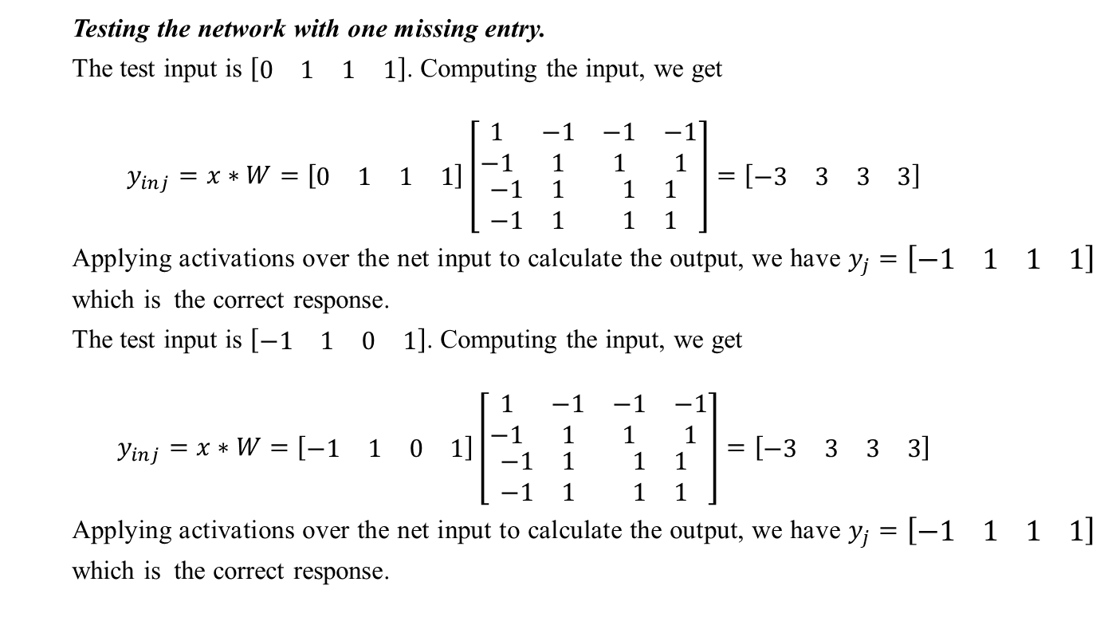
Auto-associative Memory Network
Testing the network with one missing entry.
The test input is $\left[\begin{matrix}\begin{matrix}0 & 1\end{matrix} & \begin{matrix}1 & 1\end{matrix}\end{matrix}\right]$. Computing the input, we get
$$y_{inj}=x∗W=\left[\begin{matrix}\begin{matrix}0 & 1\end{matrix} & \begin{matrix}1 & 1\end{matrix}\end{matrix}\right]\left[\begin{matrix}\begin{matrix}1 & −1 \\ −1 & 1\end{matrix} & \begin{matrix}−1 & −1 \\ 1 & 1\end{matrix} \\ \begin{matrix}−1 & 1 \\ −1 & 1\end{matrix} & \begin{matrix}1 & 1 \\ 1 & 1\end{matrix}\end{matrix}\right]=\left[\begin{matrix}\begin{matrix}−3 & 3\end{matrix} & \begin{matrix}3 & 3\end{matrix}\end{matrix}\right]$$
Applying activations over the net input to calculate the output, we have $y_{j}=\left[\begin{matrix}\begin{matrix}−1 & 1\end{matrix} & \begin{matrix}1 & 1\end{matrix}\end{matrix}\right]$ which is the correct response.
The test input is $\left[\begin{matrix}\begin{matrix}−1 & 1\end{matrix} & \begin{matrix}0 & 1\end{matrix}\end{matrix}\right]$. Computing the input, we get
$$y_{inj}=x∗W=\left[\begin{matrix}\begin{matrix}−1 & 1\end{matrix} & \begin{matrix}0 & 1\end{matrix}\end{matrix}\right]\left[\begin{matrix}\begin{matrix}1 & −1 \\ −1 & 1\end{matrix} & \begin{matrix}−1 & −1 \\ 1 & 1\end{matrix} \\ \begin{matrix}−1 & 1 \\ −1 & 1\end{matrix} & \begin{matrix}1 & 1 \\ 1 & 1\end{matrix}\end{matrix}\right]=\left[\begin{matrix}\begin{matrix}−3 & 3\end{matrix} & \begin{matrix}3 & 3\end{matrix}\end{matrix}\right]$$
Applying activations over the net input to calculate the output, we have $y_{j}=\left[\begin{matrix}\begin{matrix}−1 & 1\end{matrix} & \begin{matrix}1 & 1\end{matrix}\end{matrix}\right]$ which is the correct response.

Slide 16
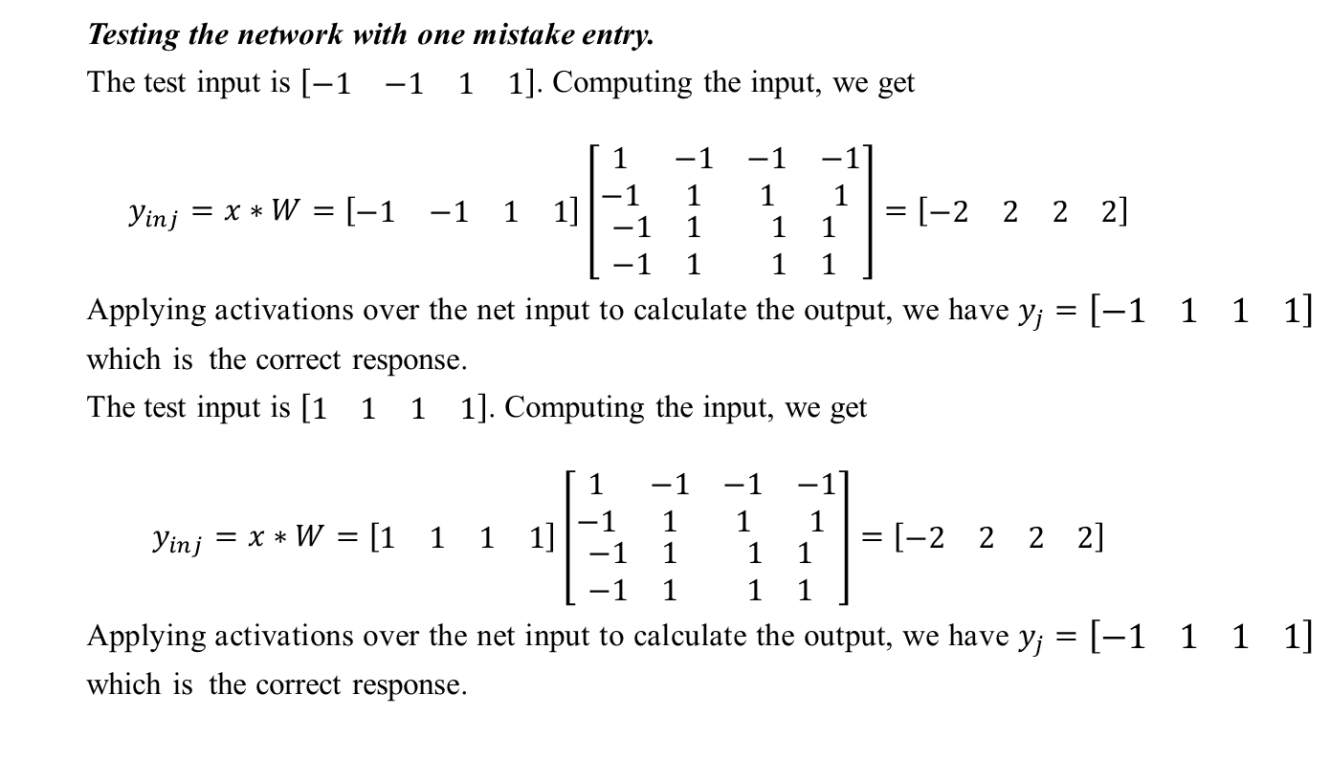
Auto-associative Memory Network
Testing the network with one mistake entry.
The test input is $\left[\begin{matrix}\begin{matrix}−1 & −1\end{matrix} & \begin{matrix}1 & 1\end{matrix}\end{matrix}\right]$. Computing the input, we get
$$y_{inj}=x∗W=\left[\begin{matrix}\begin{matrix}−1 & −1\end{matrix} & \begin{matrix}1 & 1\end{matrix}\end{matrix}\right]\left[\begin{matrix}\begin{matrix}1 & −1 \\ −1 & 1\end{matrix} & \begin{matrix}−1 & −1 \\ 1 & 1\end{matrix} \\ \begin{matrix}−1 & 1 \\ −1 & 1\end{matrix} & \begin{matrix}1 & 1 \\ 1 & 1\end{matrix}\end{matrix}\right]=\left[\begin{matrix}\begin{matrix}−2 & 2\end{matrix} & \begin{matrix}2 & 2\end{matrix}\end{matrix}\right]$$
Applying activations over the net input to calculate the output, we have $y_{j}=\left[\begin{matrix}\begin{matrix}−1 & 1\end{matrix} & \begin{matrix}1 & 1\end{matrix}\end{matrix}\right]$ which is the correct response.
The test input is $\left[\begin{matrix}\begin{matrix}1 & 1\end{matrix} & \begin{matrix}1 & 1\end{matrix}\end{matrix}\right]$. Computing the input, we get
$$y_{inj}=x∗W=\left[\begin{matrix}\begin{matrix}1 & 1\end{matrix} & \begin{matrix}1 & 1\end{matrix}\end{matrix}\right]\left[\begin{matrix}\begin{matrix}1 & −1 \\ −1 & 1\end{matrix} & \begin{matrix}−1 & −1 \\ 1 & 1\end{matrix} \\ \begin{matrix}−1 & 1 \\ −1 & 1\end{matrix} & \begin{matrix}1 & 1 \\ 1 & 1\end{matrix}\end{matrix}\right]=\left[\begin{matrix}\begin{matrix}−2 & 2\end{matrix} & \begin{matrix}2 & 2\end{matrix}\end{matrix}\right]$$
Applying activations over the net input to calculate the output, we have $y_{j}=\left[\begin{matrix}\begin{matrix}−1 & 1\end{matrix} & \begin{matrix}1 & 1\end{matrix}\end{matrix}\right]$ which is the correct response.

Slide 17
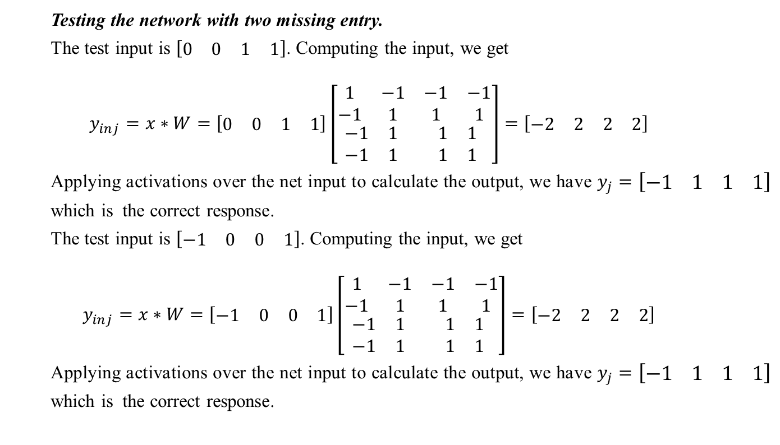
Auto-associative Memory Network
Testing the network with two missing entry.
The test input is $\left[\begin{matrix}\begin{matrix}0 & 0\end{matrix} & \begin{matrix}1 & 1\end{matrix}\end{matrix}\right]$. Computing the input, we get
$$y_{inj}=x∗W=\left[\begin{matrix}\begin{matrix}0 & 0\end{matrix} & \begin{matrix}1 & 1\end{matrix}\end{matrix}\right]\left[\begin{matrix}\begin{matrix}1 & −1 \\ −1 & 1\end{matrix} & \begin{matrix}−1 & −1 \\ 1 & 1\end{matrix} \\ \begin{matrix}−1 & 1 \\ −1 & 1\end{matrix} & \begin{matrix}1 & 1 \\ 1 & 1\end{matrix}\end{matrix}\right]=\left[\begin{matrix}\begin{matrix}−2 & 2\end{matrix} & \begin{matrix}2 & 2\end{matrix}\end{matrix}\right]$$
Applying activations over the net input to calculate the output, we have $y_{j}=\left[\begin{matrix}\begin{matrix}−1 & 1\end{matrix} & \begin{matrix}1 & 1\end{matrix}\end{matrix}\right]$ which is the correct response.
The test input is $\left[\begin{matrix}\begin{matrix}−1 & 0\end{matrix} & \begin{matrix}0 & 1\end{matrix}\end{matrix}\right]$. Computing the input, we get
$$y_{inj}=x∗W=\left[\begin{matrix}\begin{matrix}−1 & 0\end{matrix} & \begin{matrix}0 & 1\end{matrix}\end{matrix}\right]\left[\begin{matrix}\begin{matrix}1 & −1 \\ −1 & 1\end{matrix} & \begin{matrix}−1 & −1 \\ 1 & 1\end{matrix} \\ \begin{matrix}−1 & 1 \\ −1 & 1\end{matrix} & \begin{matrix}1 & 1 \\ 1 & 1\end{matrix}\end{matrix}\right]=\left[\begin{matrix}\begin{matrix}−2 & 2\end{matrix} & \begin{matrix}2 & 2\end{matrix}\end{matrix}\right]$$
Applying activations over the net input to calculate the output, we have $y_{j}=\left[\begin{matrix}\begin{matrix}−1 & 1\end{matrix} & \begin{matrix}1 & 1\end{matrix}\end{matrix}\right]$ which is the correct response.

Slide 18
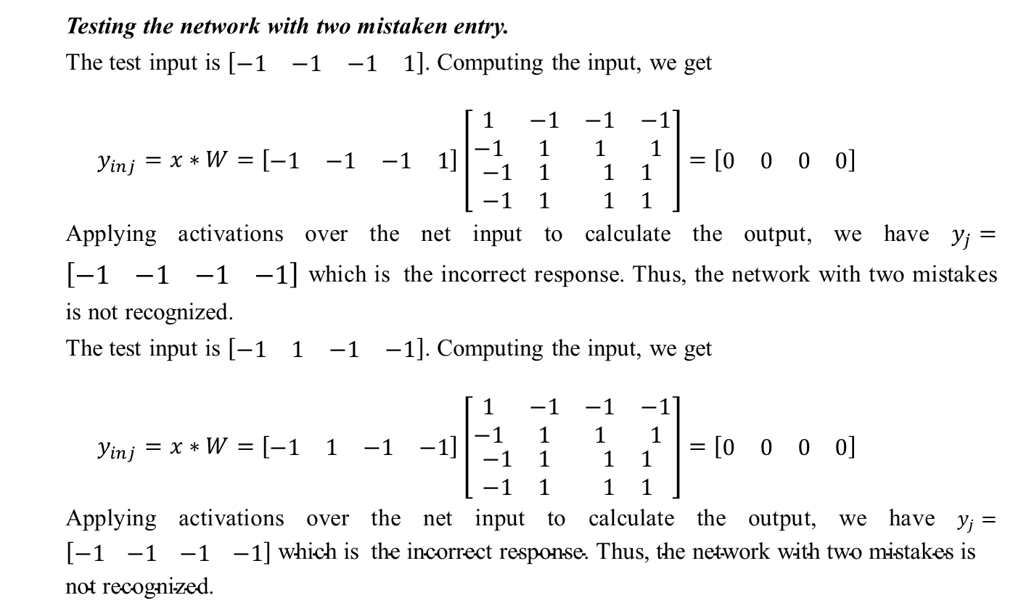
Auto-associative Memory Network
Testing the network with two mistaken entry.
The test input is $\left[\begin{matrix}\begin{matrix}−1 & −1\end{matrix} & \begin{matrix}−1 & 1\end{matrix}\end{matrix}\right]$. Computing the input, we get
$$y_{inj}=x∗W=\left[\begin{matrix}\begin{matrix}−1 & −1\end{matrix} & \begin{matrix}−1 & 1\end{matrix}\end{matrix}\right]\left[\begin{matrix}\begin{matrix}1 & −1 \\ −1 & 1\end{matrix} & \begin{matrix}−1 & −1 \\ 1 & 1\end{matrix} \\ \begin{matrix}−1 & 1 \\ −1 & 1\end{matrix} & \begin{matrix}1 & 1 \\ 1 & 1\end{matrix}\end{matrix}\right]=\left[\begin{matrix}\begin{matrix}0 & 0\end{matrix} & \begin{matrix}0 & 0\end{matrix}\end{matrix}\right]$$
Applying activations over the net input to calculate the output, we have $y_{j}=\left[\begin{matrix}\begin{matrix}−1 & −1\end{matrix} & \begin{matrix}−1 & −1\end{matrix}\end{matrix}\right]$ which is the incorrect response. Thus, the network with two mistakes is not recognized.
The test input is $\left[\begin{matrix}\begin{matrix}−1 & 1\end{matrix} & \begin{matrix}−1 & −1\end{matrix}\end{matrix}\right]$. Computing the input, we get
$$y_{inj}=x∗W=\left[\begin{matrix}\begin{matrix}−1 & 1\end{matrix} & \begin{matrix}−1 & −1\end{matrix}\end{matrix}\right]\left[\begin{matrix}\begin{matrix}1 & −1 \\ −1 & 1\end{matrix} & \begin{matrix}−1 & −1 \\ 1 & 1\end{matrix} \\ \begin{matrix}−1 & 1 \\ −1 & 1\end{matrix} & \begin{matrix}1 & 1 \\ 1 & 1\end{matrix}\end{matrix}\right]=\left[\begin{matrix}\begin{matrix}0 & 0\end{matrix} & \begin{matrix}0 & 0\end{matrix}\end{matrix}\right]$$
Applying activations over the net input to calculate the output, we have $y_{j}=\left[\begin{matrix}\begin{matrix}−1 & −1\end{matrix} & \begin{matrix}−1 & −1\end{matrix}\end{matrix}\right] \text{which} \text{is} \text{the} \text{incorrect} \text{response}\text{. }\text{Thus}\text{, }\text{the} \text{network} \text{with} \text{two} \text{mistakes} \text{is} \text{not} \text{recognized}\text{.}$

Slide 19
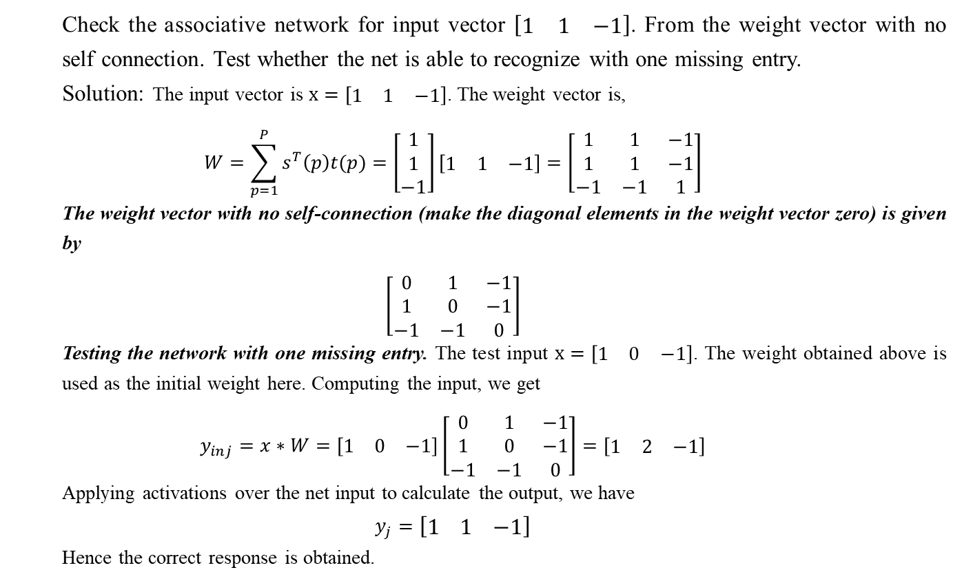
Auto-associative Memory Network
Check the associative network for input vector $\left[\begin{matrix}1 & 1 & −1\end{matrix}\right]$. From the weight vector with no self connection. Test whether the net is able to recognize with one missing entry.
Solution: The input vector is $x=\left[\begin{matrix}1 & 1 & −1\end{matrix}\right]$. The weight vector is,
$$W=\sum_{p=1}^{P}{s^{T}\left(p\right)t(p)}=\left[\begin{matrix}1 \\ 1 \\ −1\end{matrix}\right]\left[\begin{matrix}1 & 1 & −1\end{matrix}\right]=\left[\begin{matrix}1 & 1 & −1 \\ 1 & 1 & −1 \\ −1 & −1 & 1\end{matrix}\right]$$
The weight vector with no self-connection (make the diagonal elements in the weight vector zero) is given by
$$\left[\begin{matrix}0 & 1 & −1 \\ 1 & 0 & −1 \\ −1 & −1 & 0\end{matrix}\right]$$
Testing the network with one missing entry. The test input $x=\left[\begin{matrix}1 & 0 & −1\end{matrix}\right]$. The weight obtained above is used as the initial weight here. Computing the input, we get
$$y_{inj}=x∗W=\left[\begin{matrix}1 & 0 & −1\end{matrix}\right]\left[\begin{matrix}0 & 1 & −1 \\ 1 & 0 & −1 \\ −1 & −1 & 0\end{matrix}\right]=\left[\begin{matrix}1 & 2 & −1\end{matrix}\right]$$
Applying activations over the net input to calculate the output, we have
$$y_{j}=\left[\begin{matrix}1 & 1 & −1\end{matrix}\right]$$
Hence the correct response is obtained.

Slide 20
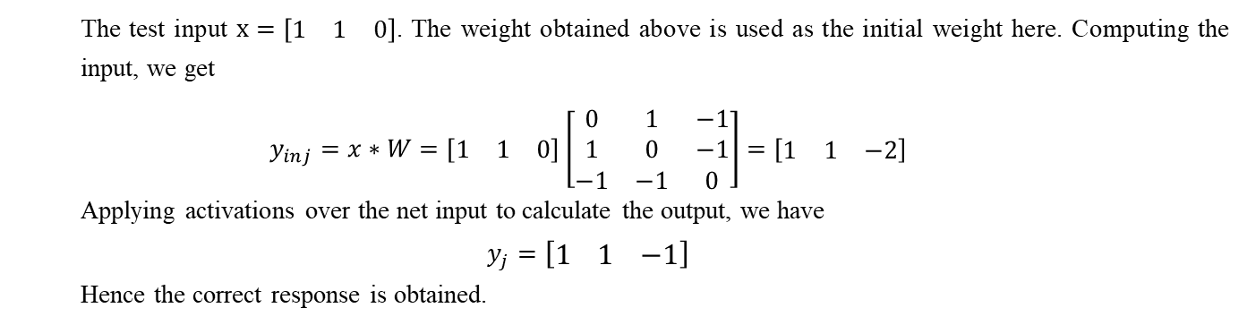
Auto-associative Memory Network
The test input $x=\left[\begin{matrix}1 & 1 & 0\end{matrix}\right]$. The weight obtained above is used as the initial weight here. Computing the input, we get
$$y_{inj}=x∗W=\left[\begin{matrix}1 & 1 & 0\end{matrix}\right]\left[\begin{matrix}0 & 1 & −1 \\ 1 & 0 & −1 \\ −1 & −1 & 0\end{matrix}\right]=\left[\begin{matrix}1 & 1 & −2\end{matrix}\right]$$
Applying activations over the net input to calculate the output, we have
$$y_{j}=\left[\begin{matrix}1 & 1 & −1\end{matrix}\right]$$
Hence the correct response is obtained.

Slide 21
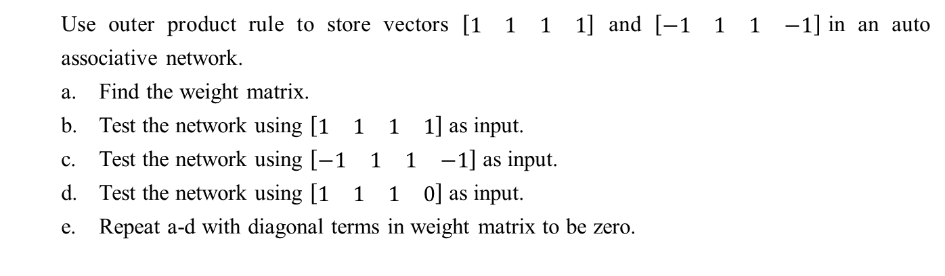
Auto-associative Memory Network
Use outer product rule to store vectors $\left[\begin{matrix}\begin{matrix}1 & 1\end{matrix} & \begin{matrix}1 & 1\end{matrix}\end{matrix}\right]$ and $\left[\begin{matrix}\begin{matrix}−1 & 1\end{matrix} & \begin{matrix}1 & −1\end{matrix}\end{matrix}\right]$in an auto associative network.
Find the weight matrix.
Test the network using $\left[\begin{matrix}\begin{matrix}1 & 1\end{matrix} & \begin{matrix}1 & 1\end{matrix}\end{matrix}\right]$ as input.
Test the network using $\left[\begin{matrix}\begin{matrix}−1 & 1\end{matrix} & \begin{matrix}1 & −1\end{matrix}\end{matrix}\right]$ as input.
Test the network using $\left[\begin{matrix}\begin{matrix}1 & 1\end{matrix} & \begin{matrix}1 & 0\end{matrix}\end{matrix}\right]$ as input.
Repeat a-d with diagonal terms in weight matrix to be zero.

Slide 22
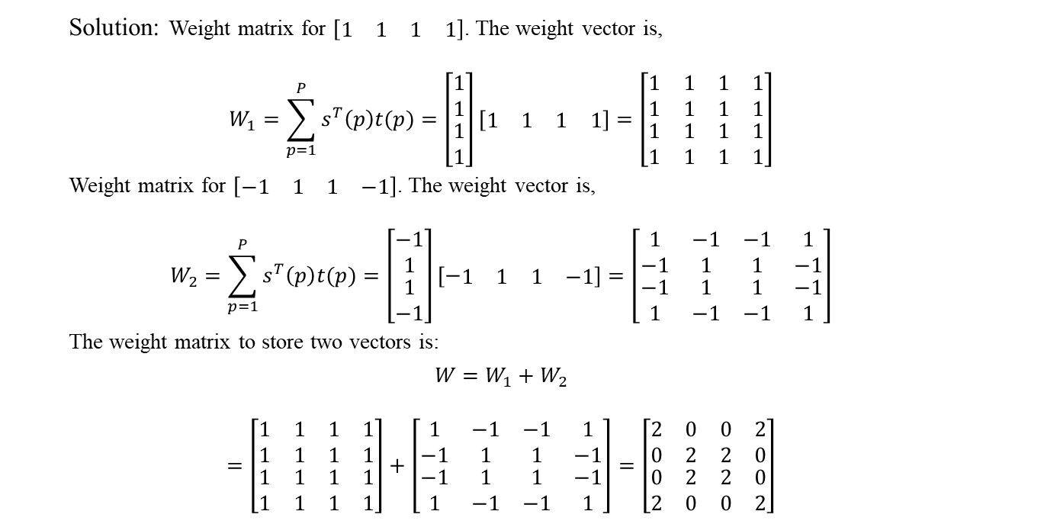
Auto-associative Memory Network
Solution: Weight matrix for $\left[\begin{matrix}\begin{matrix}1 & 1\end{matrix} & \begin{matrix}1 & 1\end{matrix}\end{matrix}\right]$. The weight vector is,
$$W_{1}=\sum_{p=1}^{P}{s^{T}\left(p\right)t(p)}=\left[\begin{matrix}\begin{matrix}1 \\ 1\end{matrix} \\ \begin{matrix}1 \\ 1\end{matrix}\end{matrix}\right]\left[\begin{matrix}\begin{matrix}1 & 1\end{matrix} & \begin{matrix}1 & 1\end{matrix}\end{matrix}\right]=\left[\begin{matrix}\begin{matrix}1 & 1 \\ 1 & 1\end{matrix} & \begin{matrix}1 & 1 \\ 1 & 1\end{matrix} \\ \begin{matrix}1 & 1 \\ 1 & 1\end{matrix} & \begin{matrix}1 & 1 \\ 1 & 1\end{matrix}\end{matrix}\right]$$
Weight matrix for $\left[\begin{matrix}\begin{matrix}−1 & 1\end{matrix} & \begin{matrix}1 & −1\end{matrix}\end{matrix}\right]$. The weight vector is,
$$W_{2}=\sum_{p=1}^{P}{s^{T}\left(p\right)t(p)}=\left[\begin{matrix}\begin{matrix}−1 \\ 1\end{matrix} \\ \begin{matrix}1 \\ −1\end{matrix}\end{matrix}\right]\left[−\begin{matrix}\begin{matrix}1 & 1\end{matrix} & \begin{matrix}1 & −1\end{matrix}\end{matrix}\right]=\left[\begin{matrix}\begin{matrix}1 & −1 \\ −1 & 1\end{matrix} & \begin{matrix}−1 & 1 \\ 1 & −1\end{matrix} \\ \begin{matrix}−1 & 1 \\ 1 & −1\end{matrix} & \begin{matrix}1 & −1 \\ −1 & 1\end{matrix}\end{matrix}\right]$$
The weight matrix to store two vectors is:
$$W=W_{1}+W_{2}$$
$$=\left[\begin{matrix}\begin{matrix}1 & 1 \\ 1 & 1\end{matrix} & \begin{matrix}1 & 1 \\ 1 & 1\end{matrix} \\ \begin{matrix}1 & 1 \\ 1 & 1\end{matrix} & \begin{matrix}1 & 1 \\ 1 & 1\end{matrix}\end{matrix}\right]+\left[\begin{matrix}\begin{matrix}1 & −1 \\ −1 & 1\end{matrix} & \begin{matrix}−1 & 1 \\ 1 & −1\end{matrix} \\ \begin{matrix}−1 & 1 \\ 1 & −1\end{matrix} & \begin{matrix}1 & −1 \\ −1 & 1\end{matrix}\end{matrix}\right]=\left[\begin{matrix}\begin{matrix}2 & 0 \\ 0 & 2\end{matrix} & \begin{matrix}0 & 2 \\ 2 & 0\end{matrix} \\ \begin{matrix}0 & 2 \\ 2 & 0\end{matrix} & \begin{matrix}2 & 0 \\ 0 & 2\end{matrix}\end{matrix}\right]$$

Slide 23
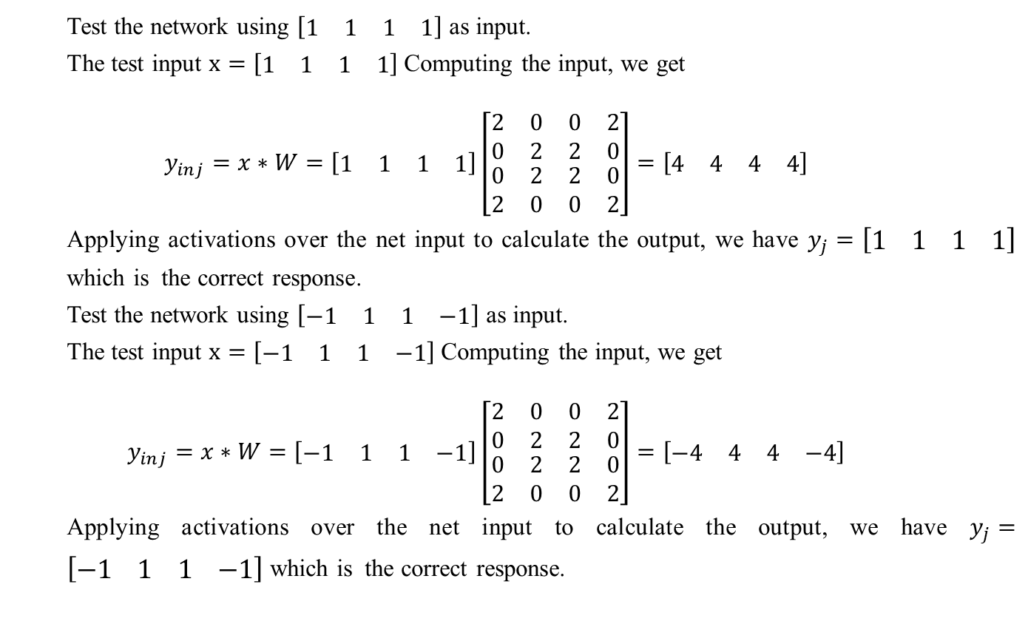
Auto-associative Memory Network
Test the network using $\left[\begin{matrix}\begin{matrix}1 & 1\end{matrix} & \begin{matrix}1 & 1\end{matrix}\end{matrix}\right]$ as input.
The test input $x=\left[\begin{matrix}\begin{matrix}1 & 1\end{matrix} & \begin{matrix}1 & 1\end{matrix}\end{matrix}\right]$Computing the input, we get
$$y_{inj}=x∗W=\left[\begin{matrix}\begin{matrix}1 & 1\end{matrix} & \begin{matrix}1 & 1\end{matrix}\end{matrix}\right]\left[\begin{matrix}\begin{matrix}2 & 0 \\ 0 & 2\end{matrix} & \begin{matrix}0 & 2 \\ 2 & 0\end{matrix} \\ \begin{matrix}0 & 2 \\ 2 & 0\end{matrix} & \begin{matrix}2 & 0 \\ 0 & 2\end{matrix}\end{matrix}\right]=\left[\begin{matrix}\begin{matrix}4 & 4\end{matrix} & \begin{matrix}4 & 4\end{matrix}\end{matrix}\right]$$
Applying activations over the net input to calculate the output, we have $y_{j}=\left[\begin{matrix}\begin{matrix}1 & 1\end{matrix} & \begin{matrix}1 & 1\end{matrix}\end{matrix}\right]$ which is the correct response.
Test the network using $\left[\begin{matrix}\begin{matrix}−1 & 1\end{matrix} & \begin{matrix}1 & −1\end{matrix}\end{matrix}\right]$ as input.
The test input $x=\left[\begin{matrix}\begin{matrix}−1 & 1\end{matrix} & \begin{matrix}1 & −1\end{matrix}\end{matrix}\right]$Computing the input, we get
$$y_{inj}=x∗W=\left[\begin{matrix}\begin{matrix}−1 & 1\end{matrix} & \begin{matrix}1 & −1\end{matrix}\end{matrix}\right]\left[\begin{matrix}\begin{matrix}2 & 0 \\ 0 & 2\end{matrix} & \begin{matrix}0 & 2 \\ 2 & 0\end{matrix} \\ \begin{matrix}0 & 2 \\ 2 & 0\end{matrix} & \begin{matrix}2 & 0 \\ 0 & 2\end{matrix}\end{matrix}\right]=\left[\begin{matrix}\begin{matrix}−4 & 4\end{matrix} & \begin{matrix}4 & −4\end{matrix}\end{matrix}\right]$$
Applying activations over the net input to calculate the output, we have $y_{j}=\left[\begin{matrix}\begin{matrix}−1 & 1\end{matrix} & \begin{matrix}1 & −1\end{matrix}\end{matrix}\right]$ which is the correct response.

Slide 24
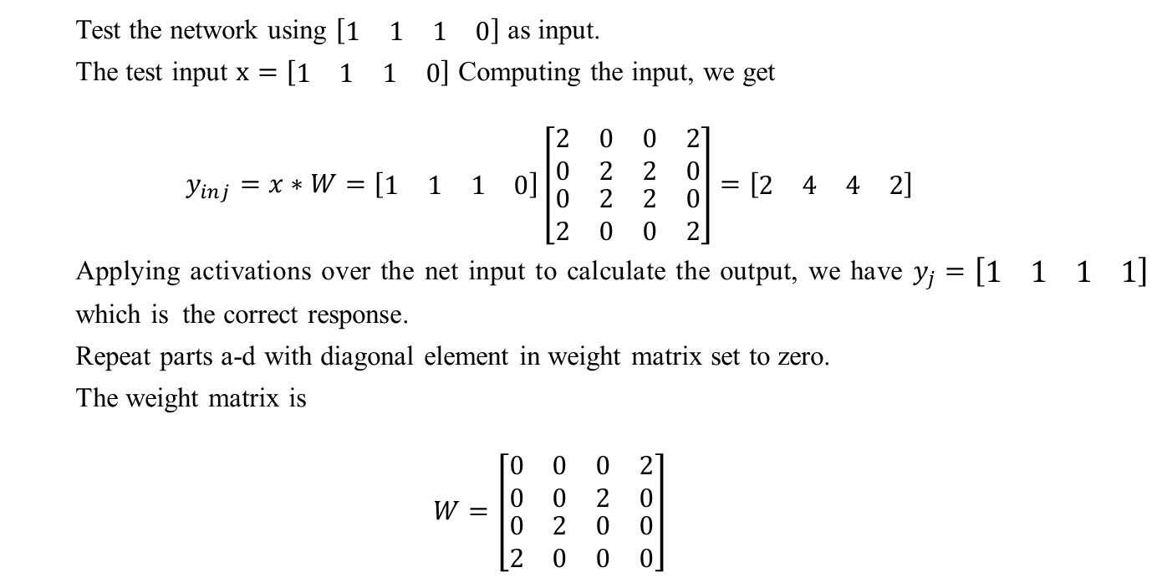
Auto-associative Memory Network
Test the network using $\left[\begin{matrix}\begin{matrix}1 & 1\end{matrix} & \begin{matrix}1 & 0\end{matrix}\end{matrix}\right]$ as input.
The test input $x=\left[\begin{matrix}\begin{matrix}1 & 1\end{matrix} & \begin{matrix}1 & 0\end{matrix}\end{matrix}\right]$ Computing the input, we get
$$y_{inj}=x∗W=\left[\begin{matrix}\begin{matrix}1 & 1\end{matrix} & \begin{matrix}1 & 0\end{matrix}\end{matrix}\right]\left[\begin{matrix}\begin{matrix}2 & 0 \\ 0 & 2\end{matrix} & \begin{matrix}0 & 2 \\ 2 & 0\end{matrix} \\ \begin{matrix}0 & 2 \\ 2 & 0\end{matrix} & \begin{matrix}2 & 0 \\ 0 & 2\end{matrix}\end{matrix}\right]=\left[\begin{matrix}\begin{matrix}2 & 4\end{matrix} & \begin{matrix}4 & 2\end{matrix}\end{matrix}\right]$$
Applying activations over the net input to calculate the output, we have $y_{j}=\left[\begin{matrix}\begin{matrix}1 & 1\end{matrix} & \begin{matrix}1 & 1\end{matrix}\end{matrix}\right]$ which is the correct response.
Repeat parts a-d with diagonal element in weight matrix set to zero.
The weight matrix is
$$W=\left[\begin{matrix}\begin{matrix}0 & 0 \\ 0 & 0\end{matrix} & \begin{matrix}0 & 2 \\ 2 & 0\end{matrix} \\ \begin{matrix}0 & 2 \\ 2 & 0\end{matrix} & \begin{matrix}0 & 0 \\ 0 & 0\end{matrix}\end{matrix}\right]$$

Slide 25
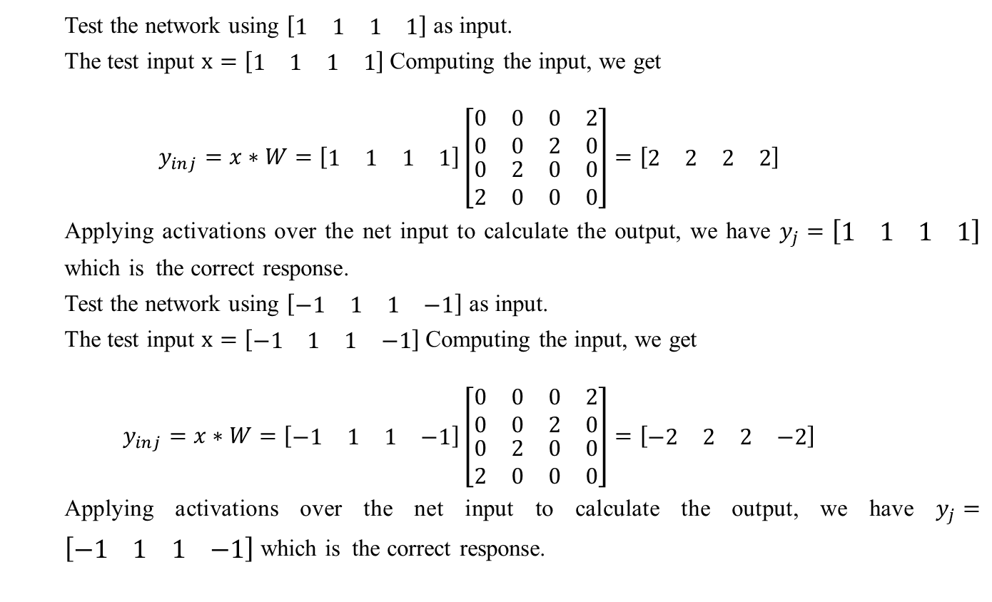
Auto-associative Memory Network
Test the network using $\left[\begin{matrix}\begin{matrix}1 & 1\end{matrix} & \begin{matrix}1 & 1\end{matrix}\end{matrix}\right]$ as input.
The test input $x=\left[\begin{matrix}\begin{matrix}1 & 1\end{matrix} & \begin{matrix}1 & 1\end{matrix}\end{matrix}\right]$Computing the input, we get
$$y_{inj}=x∗W=\left[\begin{matrix}\begin{matrix}1 & 1\end{matrix} & \begin{matrix}1 & 1\end{matrix}\end{matrix}\right]\left[\begin{matrix}\begin{matrix}0 & 0 \\ 0 & 0\end{matrix} & \begin{matrix}0 & 2 \\ 2 & 0\end{matrix} \\ \begin{matrix}0 & 2 \\ 2 & 0\end{matrix} & \begin{matrix}0 & 0 \\ 0 & 0\end{matrix}\end{matrix}\right]=\left[\begin{matrix}\begin{matrix}2 & 2\end{matrix} & \begin{matrix}2 & 2\end{matrix}\end{matrix}\right]$$
Applying activations over the net input to calculate the output, we have $y_{j}=\left[\begin{matrix}\begin{matrix}1 & 1\end{matrix} & \begin{matrix}1 & 1\end{matrix}\end{matrix}\right]$ which is the correct response.
Test the network using $\left[\begin{matrix}\begin{matrix}−1 & 1\end{matrix} & \begin{matrix}1 & −1\end{matrix}\end{matrix}\right]$ as input.
The test input $x=\left[\begin{matrix}\begin{matrix}−1 & 1\end{matrix} & \begin{matrix}1 & −1\end{matrix}\end{matrix}\right]$Computing the input, we get
$$y_{inj}=x∗W=\left[\begin{matrix}\begin{matrix}−1 & 1\end{matrix} & \begin{matrix}1 & −1\end{matrix}\end{matrix}\right]\left[\begin{matrix}\begin{matrix}0 & 0 \\ 0 & 0\end{matrix} & \begin{matrix}0 & 2 \\ 2 & 0\end{matrix} \\ \begin{matrix}0 & 2 \\ 2 & 0\end{matrix} & \begin{matrix}0 & 0 \\ 0 & 0\end{matrix}\end{matrix}\right]=\left[\begin{matrix}\begin{matrix}−2 & 2\end{matrix} & \begin{matrix}2 & −2\end{matrix}\end{matrix}\right]$$
Applying activations over the net input to calculate the output, we have $y_{j}=\left[\begin{matrix}\begin{matrix}−1 & 1\end{matrix} & \begin{matrix}1 & −1\end{matrix}\end{matrix}\right]$ which is the correct response.

Slide 26
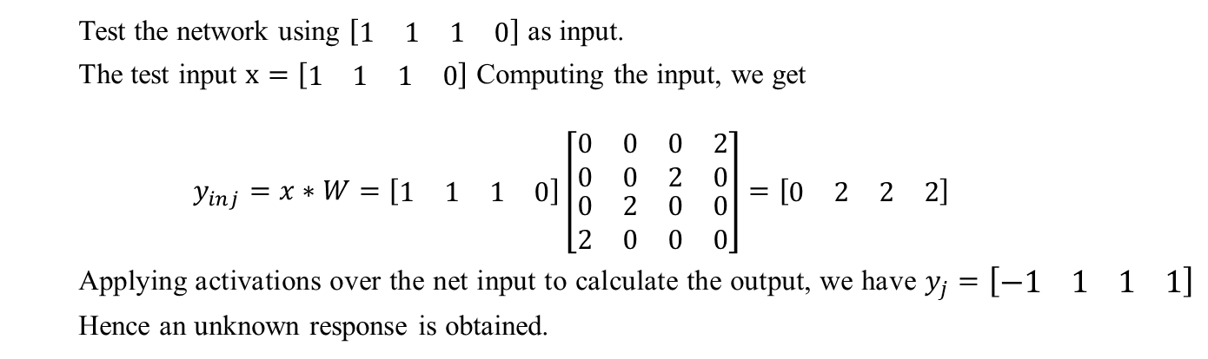
Auto-associative Memory Network
Test the network using $\left[\begin{matrix}\begin{matrix}1 & 1\end{matrix} & \begin{matrix}1 & 0\end{matrix}\end{matrix}\right]$ as input.
The test input $x=\left[\begin{matrix}\begin{matrix}1 & 1\end{matrix} & \begin{matrix}1 & 0\end{matrix}\end{matrix}\right]$ Computing the input, we get
$$y_{inj}=x∗W=\left[\begin{matrix}\begin{matrix}1 & 1\end{matrix} & \begin{matrix}1 & 0\end{matrix}\end{matrix}\right]\left[\begin{matrix}\begin{matrix}0 & 0 \\ 0 & 0\end{matrix} & \begin{matrix}0 & 2 \\ 2 & 0\end{matrix} \\ \begin{matrix}0 & 2 \\ 2 & 0\end{matrix} & \begin{matrix}0 & 0 \\ 0 & 0\end{matrix}\end{matrix}\right]=\left[\begin{matrix}\begin{matrix}0 & 2\end{matrix} & \begin{matrix}2 & 2\end{matrix}\end{matrix}\right]$$
Applying activations over the net input to calculate the output, we have $y_{j}=\left[\begin{matrix}\begin{matrix}−1 & 1\end{matrix} & \begin{matrix}1 & 1\end{matrix}\end{matrix}\right]$ Hence an unknown response is obtained.

Slide 27
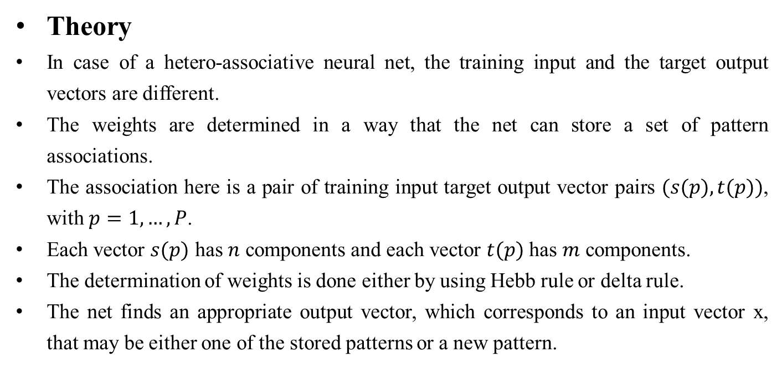
Hetero-associative Memory Network
Theory
In case of a hetero-associative neural net, the training input and the target output vectors are different.
The weights are determined in a way that the net can store a set of pattern associations.
The association here is a pair of training input target output vector pairs $(s(p), t(p))$, with $p=1,…,P$.
Each vector $s(p)$ has $n$ components and each vector $t(p)$ has $m$ components.
The determination of weights is done either by using Hebb rule or delta rule.
The net finds an appropriate output vector, which corresponds to an input vector x, that may be either one of the stored patterns or a new pattern.

Slide 28
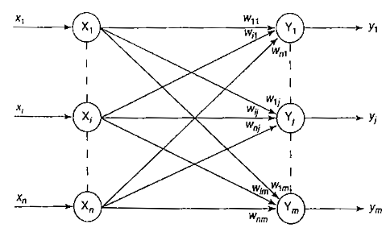
Hetero-associative Memory Network
Architecture
The architecture of an hetero-associative neural net is shown in Figure. From the figure, it can be noticed that for a hetero-associative net, the training input and target output vectors are different.
The input layer consist of n number of input units and the output layer consists of m number of output units.
There exist weighted interconnections between the input and output layers.
The input and output layer units are not correlated with each other.

Slide 29
Hetero-associative Memory Network
Training Algorithm
Step 0: initialize all the weights to zero,
$w_{ij}=0 (i=1 to n, j=1 to m)$
Step 1: for each of the vector that has to be stored perform Steps 2-4.
Step 2: activate each of the input unit,
$$x_{i}=s_{i} (for i=1 to n)$$
Step 3: activate each of the output unit,
$y_{j}=t_{j} (for j=1 to m)$
Step 4: Adjust the weights,
$$w_{ij}\left(new\right)=w_{ij}\left(old\right)+x_{i}y_{j}$$
The weights can also be determined by the formula
$$W=\sum_{p=1}^{P}{s^{T}\left(p\right)t(p)}$$

Slide 30
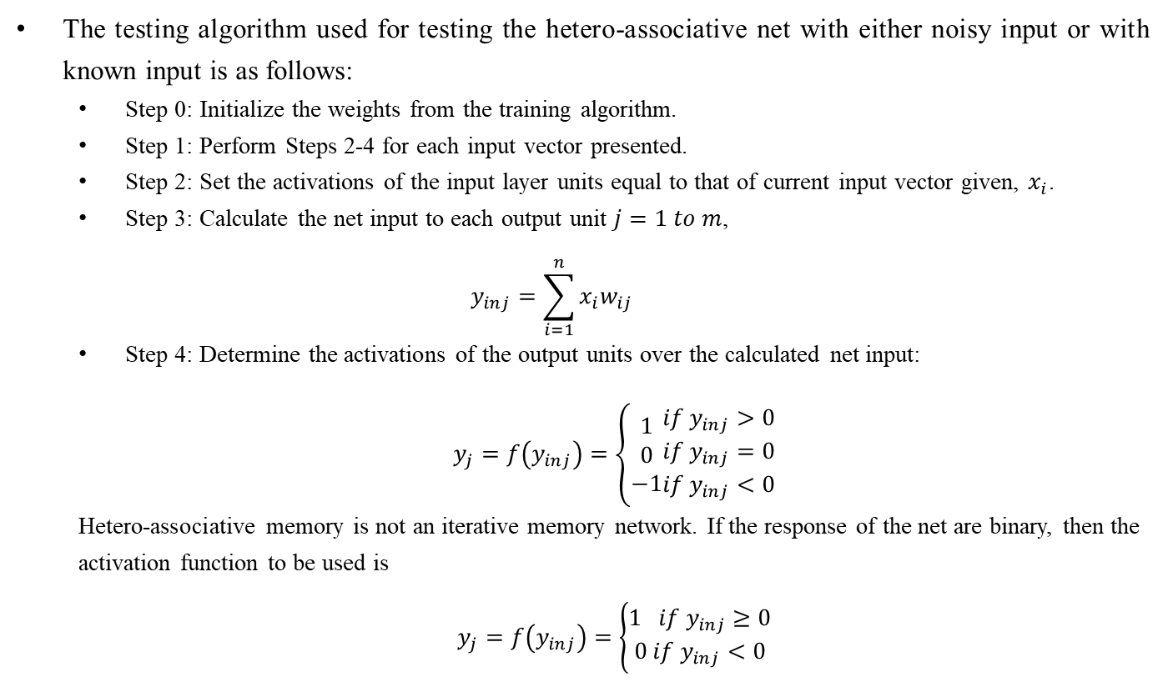
Hetero-associative Memory Network
The testing algorithm used for testing the hetero-associative net with either noisy input or with known input is as follows:
Step 0: Initialize the weights from the training algorithm.
Step 1: Perform Steps 2-4 for each input vector presented.
Step 2: Set the activations of the input layer units equal to that of current input vector given, $x_{i}$.
Step 3: Calculate the net input to each output unit $j=1 to m$,
$$y_{inj}=\sum_{i=1}^{n}{x_{i}w_{ij}}$$
Step 4: Determine the activations of the output units over the calculated net input:
$y_{j}=f\left(y_{inj}\right)=\left\{\begin{matrix}1 \\ 0 \\ −1\end{matrix}\begin{matrix}if y_{inj}>0 \\ if y_{inj}=0 \\ if y_{inj}<0\end{matrix}\right.$
Hetero-associative memory is not an iterative memory network. If the response of the net are binary, then the activation function to be used is
$y_{j}=f\left(y_{inj}\right)=\left\{\begin{aligned}1 if y_{inj}≥0 \\ 0 if y_{inj}<0\end{aligned}\right.$

Slide 31
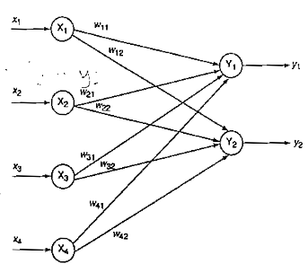
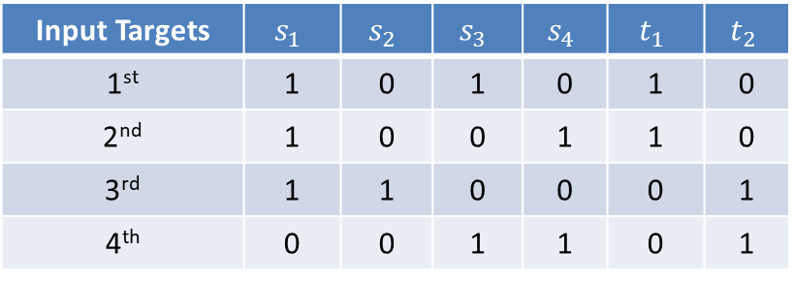
Hetero-associative Memory Network
Train a hetero-associative memory network using Hebb rule to store input row vector $s=(s_{1},s_{2},s_{3},s_{4})$ to the output row vector $t=\left(t_{1},t_{2}\right).$The vector pairs are given in table.
Input Targets | $$s_{1}$$ | $$s_{2}$$ | $$s_{3}$$ | $$s_{4}$$ | $$t_{1}$$ | $$t_{2}$$
1st | 1 | 0 | 1 | 0 | 1 | 0
2nd | 1 | 0 | 0 | 1 | 1 | 0
3rd | 1 | 1 | 0 | 0 | 0 | 1
4th | 0 | 0 | 1 | 1 | 0 | 1
The network for the given problem is as shown in Figure. The training algorithm based on Hebb rule is used to determine the weights.

Slide 32
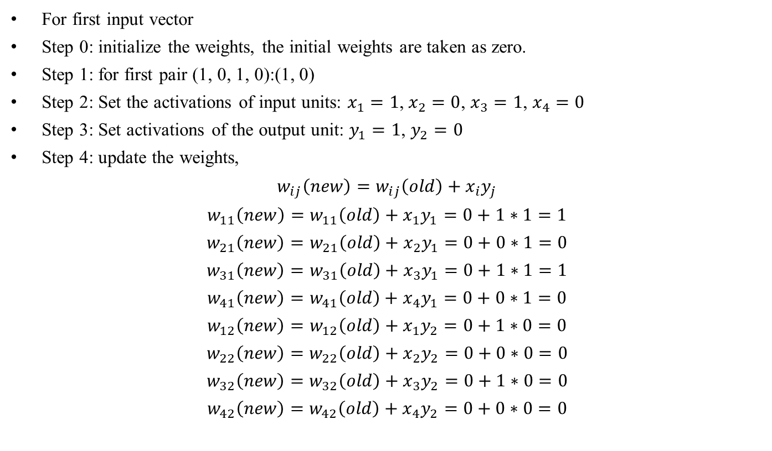
Hetero-associative Memory Network
For first input vector
Step 0: initialize the weights, the initial weights are taken as zero.
Step 1: for first pair (1, 0, 1, 0):(1, 0)
Step 2: Set the activations of input units: $x_{1}=1$, $x_{2}=0$, $x_{3}=1$, $x_{4}=0$
Step 3: Set activations of the output unit: $y_{1}=1$, $y_{2}=0$
Step 4: update the weights,
$$w_{ij}\left(new\right)=w_{ij}\left(old\right)+x_{i}y_{j}$$
$$w_{11}\left(new\right)=w_{11}\left(old\right)+x_{1}y_{1}=0+1∗1=1$$
$$w_{21}\left(new\right)=w_{21}\left(old\right)+x_{2}y_{1}=0+0∗1=0$$
$$w_{31}\left(new\right)=w_{31}\left(old\right)+x_{3}y_{1}=0+1∗1=1$$
$$w_{41}\left(new\right)=w_{41}\left(old\right)+x_{4}y_{1}=0+0∗1=0$$
$$w_{12}\left(new\right)=w_{12}\left(old\right)+x_{1}y_{2}=0+1∗0=0$$
$$w_{22}\left(new\right)=w_{22}\left(old\right)+x_{2}y_{2}=0+0∗0=0$$
$$w_{32}\left(new\right)=w_{32}\left(old\right)+x_{3}y_{2}=0+1∗0=0$$
$$w_{42}\left(new\right)=w_{42}\left(old\right)+x_{4}y_{2}=0+0∗0=0$$

Slide 33
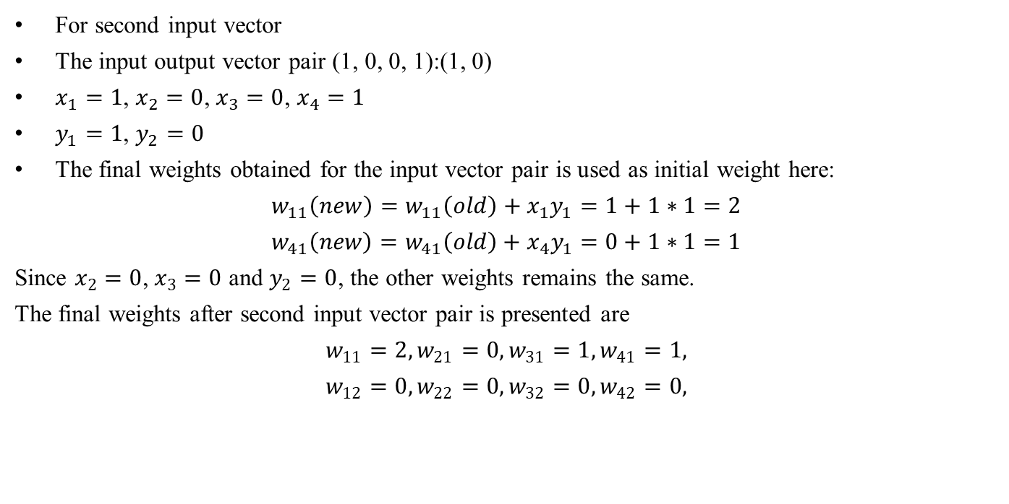
Hetero-associative Memory Network
For second input vector
The input output vector pair (1, 0, 0, 1):(1, 0)
$x_{1}=1$, $x_{2}=0$, $x_{3}=0$, $x_{4}=1$
$y_{1}=1$, $y_{2}=0$
The final weights obtained for the input vector pair is used as initial weight here:
$$w_{11}\left(new\right)=w_{11}\left(old\right)+x_{1}y_{1}=1+1∗1=2$$
$$w_{41}\left(new\right)=w_{41}\left(old\right)+x_{4}y_{1}=0+1∗1=1$$
Since $x_{2}=0$, $x_{3}=0$ and $y_{2}=0$, the other weights remains the same.
The final weights after second input vector pair is presented are
$$w_{11}=2,w_{21}=0,w_{31}=1,w_{41}=1,$$
$$w_{12}=0,w_{22}=0,w_{32}=0,w_{42}=0,$$

Slide 34
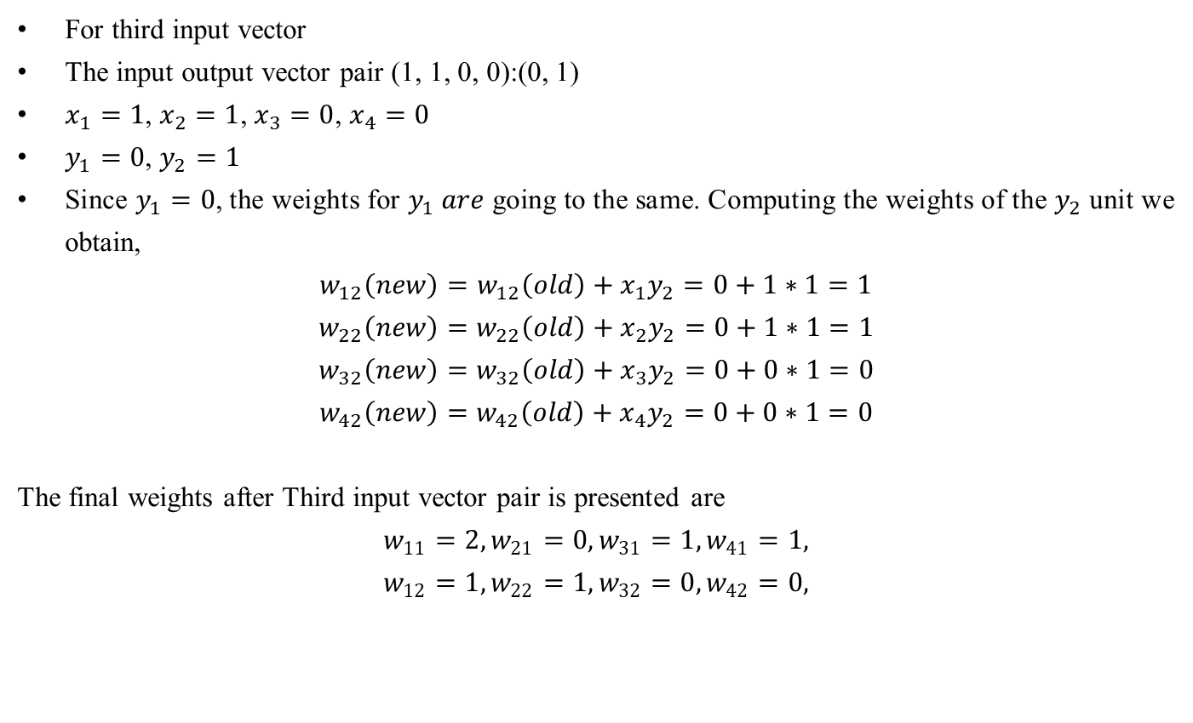
Hetero-associative Memory Network
For third input vector
The input output vector pair (1, 1, 0, 0):(0, 1)
$x_{1}=1$, $x_{2}=1$, $x_{3}=0$, $x_{4}=0$
$y_{1}=0$, $y_{2}=1$
Since $y_{1}=0$, the weights for $y_{1} are$going to the same. Computing the weights of the $y_{2}$ unit we obtain,
$$w_{12}\left(new\right)=w_{12}\left(old\right)+x_{1}y_{2}=0+1∗1=1$$
$$w_{22}\left(new\right)=w_{22}\left(old\right)+x_{2}y_{2}=0+1∗1=1$$
$$w_{32}\left(new\right)=w_{32}\left(old\right)+x_{3}y_{2}=0+0∗1=0$$
$$w_{42}\left(new\right)=w_{42}\left(old\right)+x_{4}y_{2}=0+0∗1=0$$
The final weights after Third input vector pair is presented are
$$w_{11}=2,w_{21}=0,w_{31}=1,w_{41}=1,$$
$$w_{12}=1,w_{22}=1,w_{32}=0,w_{42}=0,$$

Slide 35
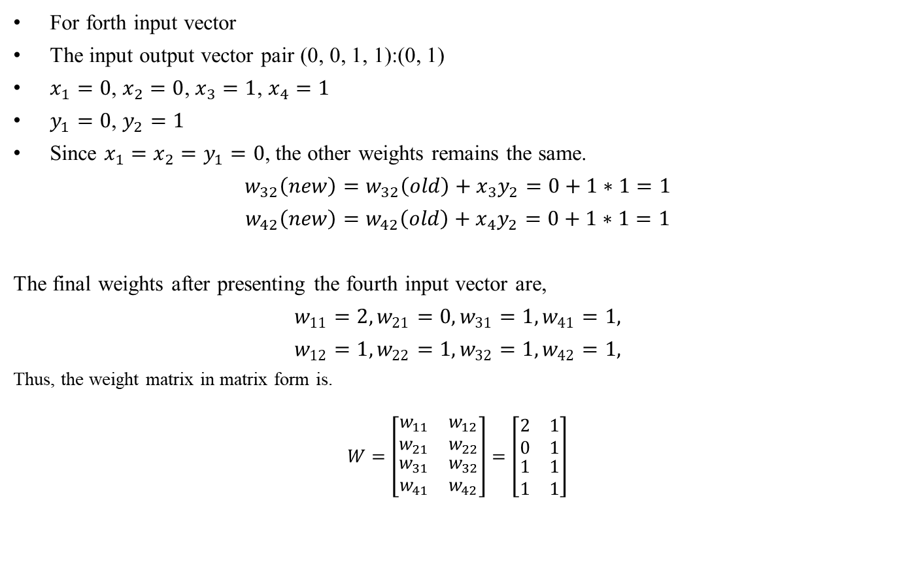
Hetero-associative Memory Network
For forth input vector
The input output vector pair (0, 0, 1, 1):(0, 1)
$x_{1}=0$, $x_{2}=0$, $x_{3}=1$, $x_{4}=1$
$y_{1}=0$, $y_{2}=1$
Since ${x_{1}=x_{2}=y}_{1}=0$, the other weights remains the same.
$$w_{32}\left(new\right)=w_{32}\left(old\right)+x_{3}y_{2}=0+1∗1=1$$
$$w_{42}\left(new\right)=w_{42}\left(old\right)+x_{4}y_{2}=0+1∗1=1$$
The final weights after presenting the fourth input vector are,
$$w_{11}=2,w_{21}=0,w_{31}=1,w_{41}=1,$$
$$w_{12}=1,w_{22}=1,w_{32}=1,w_{42}=1,$$
Thus, the weight matrix in matrix form is.
$$W=\left[\begin{matrix}\begin{matrix}\begin{matrix}w_{11} \\ w_{21}\end{matrix} \\ \begin{matrix}w_{31} \\ w_{41}\end{matrix}\end{matrix} & \begin{matrix}\begin{matrix}w_{12} \\ w_{22}\end{matrix} \\ \begin{matrix}w_{32} \\ w_{42}\end{matrix}\end{matrix}\end{matrix}\right]=\left[\begin{matrix}\begin{matrix}\begin{matrix}2 \\ 0\end{matrix} \\ \begin{matrix}1 \\ 1\end{matrix}\end{matrix} & \begin{matrix}\begin{matrix}1 \\ 1\end{matrix} \\ \begin{matrix}1 \\ 1\end{matrix}\end{matrix}\end{matrix}\right]$$

Slide 36
Hetero-associative Memory Network
Train a hetero-associative memory network using outer products rule to store input row vectors $s=(s_{1},s_{2},s_{3},s_{4})$ to the output row vector $t=\left(t_{1},t_{2}\right).$The vector pairs are given in table.
Input Targets | $$s_{1}$$ | $$s_{2}$$ | $$s_{3}$$ | $$s_{4}$$ | $$t_{1}$$ | $$t_{2}$$
1st | 1 | 0 | 1 | 0 | 1 | 0
2nd | 1 | 0 | 0 | 1 | 1 | 0
3rd | 1 | 1 | 0 | 0 | 0 | 1
4th | 0 | 0 | 1 | 1 | 0 | 1

Slide 37
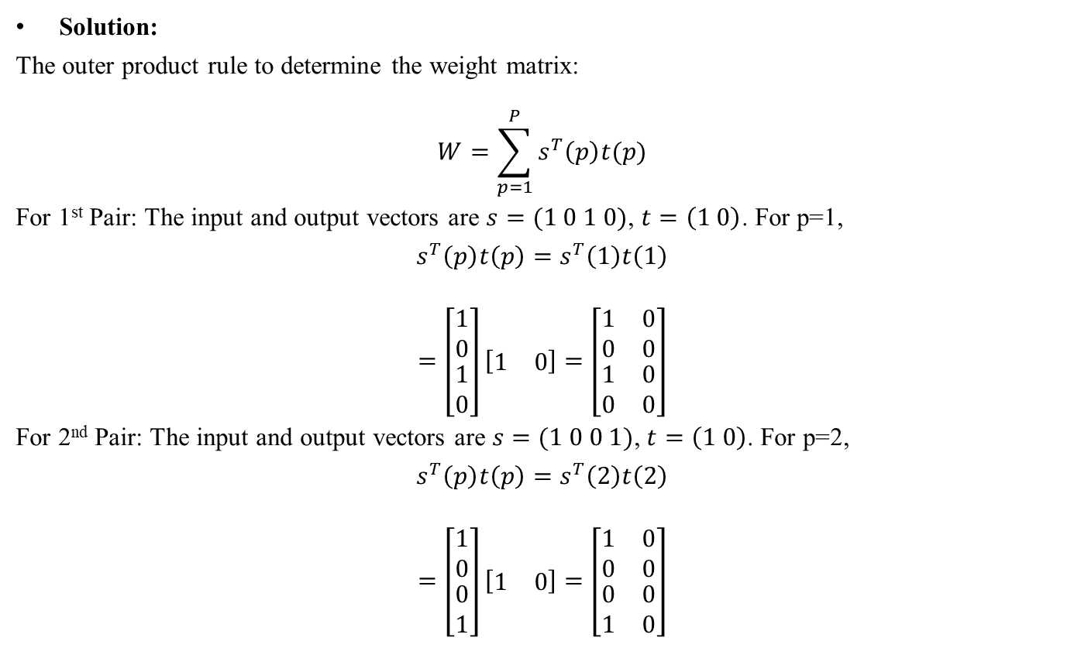
Hetero-associative Memory Network
Solution:
The outer product rule to determine the weight matrix:
$$W=\sum_{p=1}^{P}{s^{T}\left(p\right)t(p)}$$
For 1st Pair: The input and output vectors are $s=(1 0 1 0)$, $t=\left(1 0\right)$. For p=1,
$$s^{T}\left(p\right)t\left(p\right)=s^{T}\left(1\right)t\left(1\right)$$
$$=\left[\begin{matrix}\begin{matrix}1 \\ 0\end{matrix} \\ \begin{matrix}1 \\ 0\end{matrix}\end{matrix}\right]\left[\begin{matrix}1 & 0\end{matrix}\right]=\left[\begin{matrix}\begin{matrix}1 & 0 \\ 0 & 0\end{matrix} \\ \begin{matrix}1 & 0 \\ 0 & 0\end{matrix}\end{matrix}\right]$$
For 2nd Pair: The input and output vectors are $s=(1 0 0 1)$, $t=\left(1 0\right)$. For p=2,
$$s^{T}\left(p\right)t\left(p\right)=s^{T}\left(2\right)t\left(2\right)$$
$$=\left[\begin{matrix}\begin{matrix}1 \\ 0\end{matrix} \\ \begin{matrix}0 \\ 1\end{matrix}\end{matrix}\right]\left[\begin{matrix}1 & 0\end{matrix}\right]=\left[\begin{matrix}\begin{matrix}1 & 0 \\ 0 & 0\end{matrix} \\ \begin{matrix}0 & 0 \\ 1 & 0\end{matrix}\end{matrix}\right]$$

Slide 38
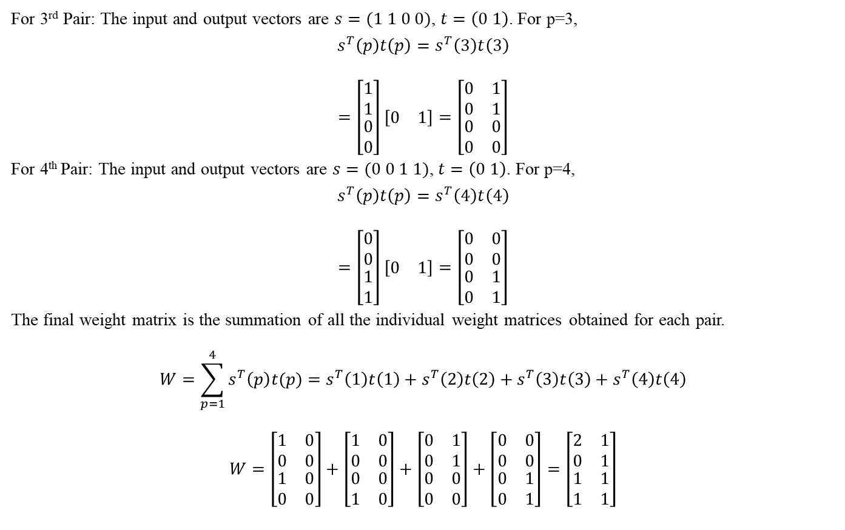
Hetero-associative Memory Network
For 3rd Pair: The input and output vectors are $s=(1 1 0 0)$, $t=\left(0 1\right)$. For p=3,
$$s^{T}\left(p\right)t\left(p\right)=s^{T}\left(3\right)t\left(3\right)$$
$$=\left[\begin{matrix}\begin{matrix}1 \\ 1\end{matrix} \\ \begin{matrix}0 \\ 0\end{matrix}\end{matrix}\right]\left[\begin{matrix}0 & 1\end{matrix}\right]=\left[\begin{matrix}\begin{matrix}0 & 1 \\ 0 & 1\end{matrix} \\ \begin{matrix}0 & 0 \\ 0 & 0\end{matrix}\end{matrix}\right]$$
For 4th Pair: The input and output vectors are $s=(0 0 1 1)$, $t=\left(0 1\right)$. For p=4,
$$s^{T}\left(p\right)t\left(p\right)=s^{T}\left(4\right)t\left(4\right)$$
$$=\left[\begin{matrix}\begin{matrix}0 \\ 0\end{matrix} \\ \begin{matrix}1 \\ 1\end{matrix}\end{matrix}\right]\left[\begin{matrix}0 & 1\end{matrix}\right]=\left[\begin{matrix}\begin{matrix}0 & 0 \\ 0 & 0\end{matrix} \\ \begin{matrix}0 & 1 \\ 0 & 1\end{matrix}\end{matrix}\right]$$
The final weight matrix is the summation of all the individual weight matrices obtained for each pair.
$$W=\sum_{p=1}^{4}{s^{T}\left(p\right)t(p)}=s^{T}\left(1\right)t\left(1\right)+s^{T}\left(2\right)t\left(2\right)+s^{T}\left(3\right)t\left(3\right)+s^{T}\left(4\right)t\left(4\right)$$
$$W=\left[\begin{matrix}\begin{matrix}1 & 0 \\ 0 & 0\end{matrix} \\ \begin{matrix}1 & 0 \\ 0 & 0\end{matrix}\end{matrix}\right]+\left[\begin{matrix}\begin{matrix}1 & 0 \\ 0 & 0\end{matrix} \\ \begin{matrix}0 & 0 \\ 1 & 0\end{matrix}\end{matrix}\right]+\left[\begin{matrix}\begin{matrix}0 & 1 \\ 0 & 1\end{matrix} \\ \begin{matrix}0 & 0 \\ 0 & 0\end{matrix}\end{matrix}\right]+\left[\begin{matrix}\begin{matrix}0 & 0 \\ 0 & 0\end{matrix} \\ \begin{matrix}0 & 1 \\ 0 & 1\end{matrix}\end{matrix}\right]=\left[\begin{matrix}\begin{matrix}2 & 1 \\ 0 & 1\end{matrix} \\ \begin{matrix}1 & 1 \\ 1 & 1\end{matrix}\end{matrix}\right]$$

Slide 39
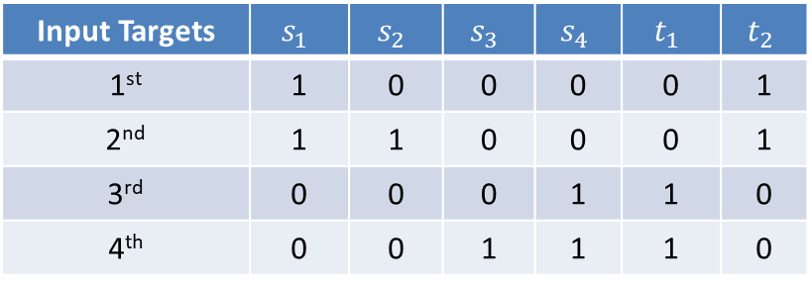
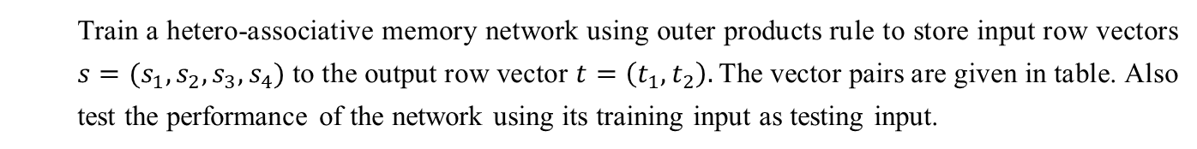
Hetero-associative Memory Network
Train a hetero-associative memory network using outer products rule to store input row vectors $s=(s_{1},s_{2},s_{3},s_{4})$ to the output row vector $t=\left(t_{1},t_{2}\right).$The vector pairs are given in table. Also test the performance of the network using its training input as testing input.
Input Targets | $$s_{1}$$ | $$s_{2}$$ | $$s_{3}$$ | $$s_{4}$$ | $$t_{1}$$ | $$t_{2}$$
1st | 1 | 0 | 0 | 0 | 0 | 1
2nd | 1 | 1 | 0 | 0 | 0 | 1
3rd | 0 | 0 | 0 | 1 | 1 | 0
4th | 0 | 0 | 1 | 1 | 1 | 0

Slide 40
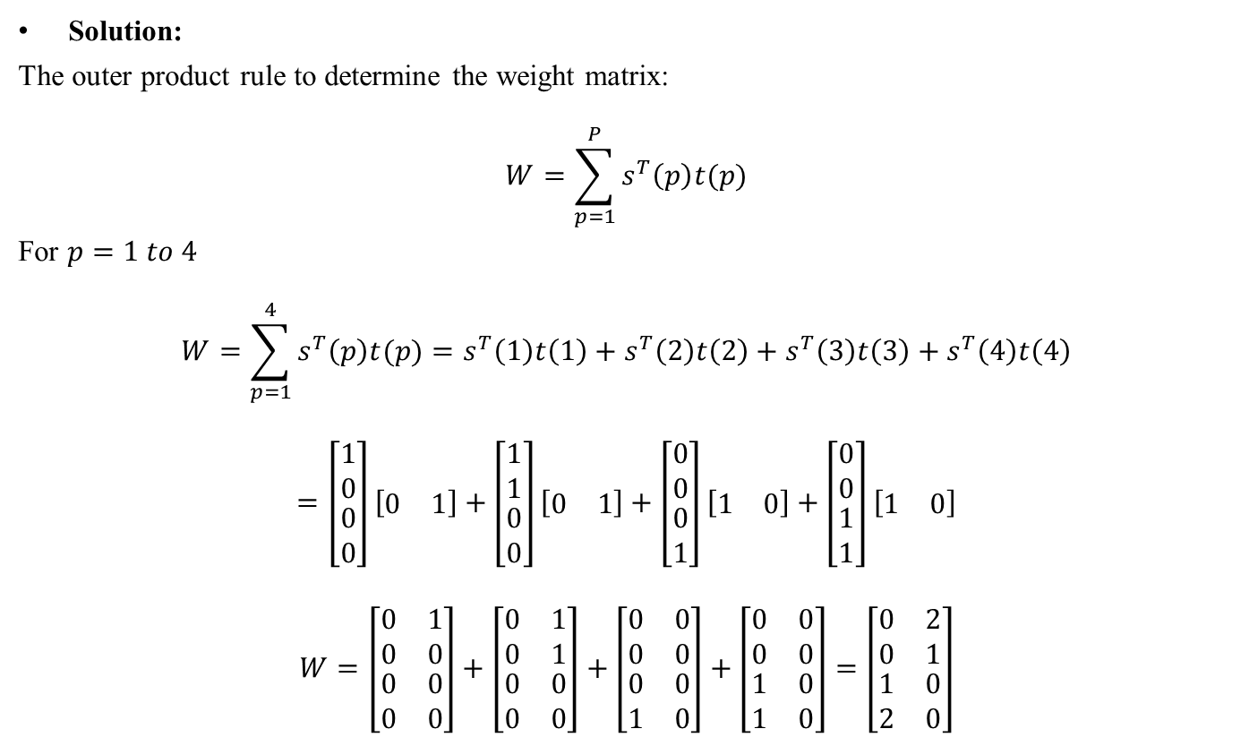
Hetero-associative Memory Network
Solution:
The outer product rule to determine the weight matrix:
$$W=\sum_{p=1}^{P}{s^{T}\left(p\right)t(p)}$$
For $p=1 to 4$
$$W=\sum_{p=1}^{4}{s^{T}\left(p\right)t(p)}=s^{T}\left(1\right)t\left(1\right)+s^{T}\left(2\right)t\left(2\right)+s^{T}\left(3\right)t\left(3\right)+s^{T}\left(4\right)t\left(4\right)$$
$$=\left[\begin{matrix}\begin{matrix}1 \\ 0\end{matrix} \\ \begin{matrix}0 \\ 0\end{matrix}\end{matrix}\right]\left[\begin{matrix}0 & 1\end{matrix}\right]+\left[\begin{matrix}\begin{matrix}1 \\ 1\end{matrix} \\ \begin{matrix}0 \\ 0\end{matrix}\end{matrix}\right]\left[\begin{matrix}0 & 1\end{matrix}\right]+\left[\begin{matrix}\begin{matrix}0 \\ 0\end{matrix} \\ \begin{matrix}0 \\ 1\end{matrix}\end{matrix}\right]\left[\begin{matrix}1 & 0\end{matrix}\right]+\left[\begin{matrix}\begin{matrix}0 \\ 0\end{matrix} \\ \begin{matrix}1 \\ 1\end{matrix}\end{matrix}\right]\left[\begin{matrix}1 & 0\end{matrix}\right]$$
$$W=\left[\begin{matrix}\begin{matrix}0 & 1 \\ 0 & 0\end{matrix} \\ \begin{matrix}0 & 0 \\ 0 & 0\end{matrix}\end{matrix}\right]+\left[\begin{matrix}\begin{matrix}0 & 1 \\ 0 & 1\end{matrix} \\ \begin{matrix}0 & 0 \\ 0 & 0\end{matrix}\end{matrix}\right]+\left[\begin{matrix}\begin{matrix}0 & 0 \\ 0 & 0\end{matrix} \\ \begin{matrix}0 & 0 \\ 1 & 0\end{matrix}\end{matrix}\right]+\left[\begin{matrix}\begin{matrix}0 & 0 \\ 0 & 0\end{matrix} \\ \begin{matrix}1 & 0 \\ 1 & 0\end{matrix}\end{matrix}\right]=\left[\begin{matrix}\begin{matrix}0 & 2 \\ 0 & 1\end{matrix} \\ \begin{matrix}1 & 0 \\ 2 & 0\end{matrix}\end{matrix}\right]$$

Slide 41
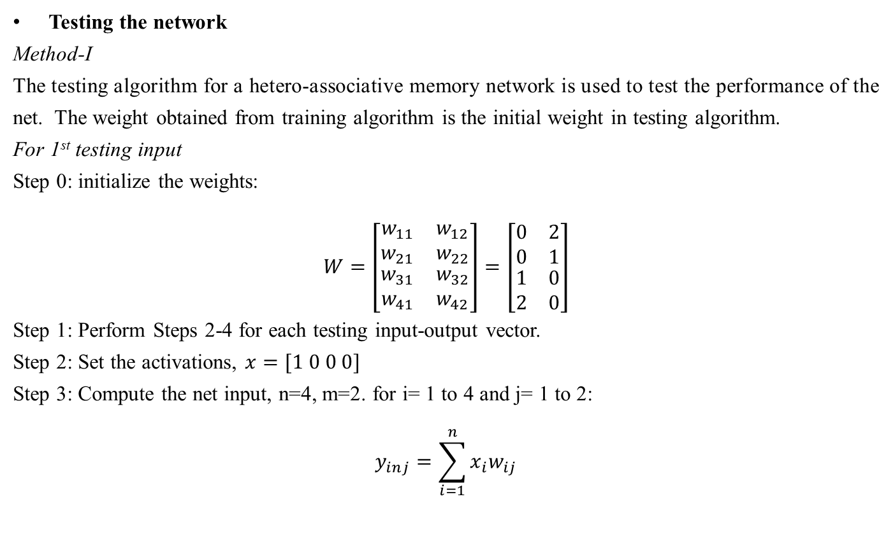
Hetero-associative Memory Network
Testing the network
Method-I
The testing algorithm for a hetero-associative memory network is used to test the performance of the net. The weight obtained from training algorithm is the initial weight in testing algorithm.
For 1st testing input
Step 0: initialize the weights:
$$W=\left[\begin{matrix}\begin{matrix}w_{11} & w_{12} \\ w_{21} & w_{22}\end{matrix} \\ \begin{matrix}w_{31} & w_{32} \\ w_{41} & w_{42}\end{matrix}\end{matrix}\right]=\left[\begin{matrix}\begin{matrix}0 & 2 \\ 0 & 1\end{matrix} \\ \begin{matrix}1 & 0 \\ 2 & 0\end{matrix}\end{matrix}\right]$$
Step 1: Perform Steps 2-4 for each testing input-output vector.
Step 2: Set the activations, $x=[1 0 0 0]$
Step 3: Compute the net input, n=4, m=2. for i= 1 to 4 and j= 1 to 2:
$$y_{inj}=\sum_{i=1}^{n}{x_{i}w_{ij}}$$

Slide 42
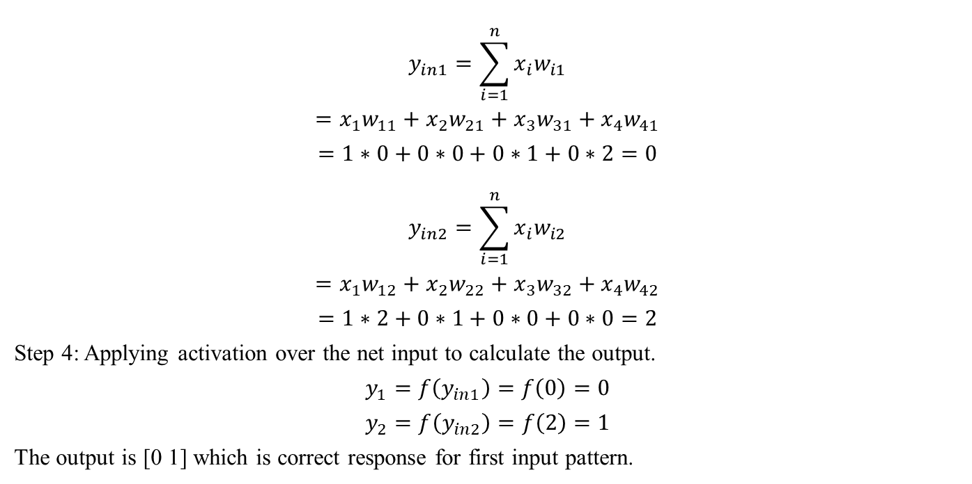
Hetero-associative Memory Network
$$y_{in1}=\sum_{i=1}^{n}{x_{i}w_{i1}}$$
$$=x_{1}w_{11}+x_{2}w_{21}+x_{3}w_{31}+x_{4}w_{41}$$
$$=1∗0+0∗0+0∗1+0∗2=0$$
$$y_{in2}=\sum_{i=1}^{n}{x_{i}w_{i2}}$$
$$=x_{1}w_{12}+x_{2}w_{22}+x_{3}w_{32}+x_{4}w_{42}$$
$$=1∗2+0∗1+0∗0+0∗0=2$$
Step 4: Applying activation over the net input to calculate the output.
$$y_{1}=f\left(y_{in1}\right)=f\left(0\right)=0$$
$$y_{2}=f\left(y_{in2}\right)=f\left(2\right)=1$$
The output is [0 1] which is correct response for first input pattern.

Slide 43
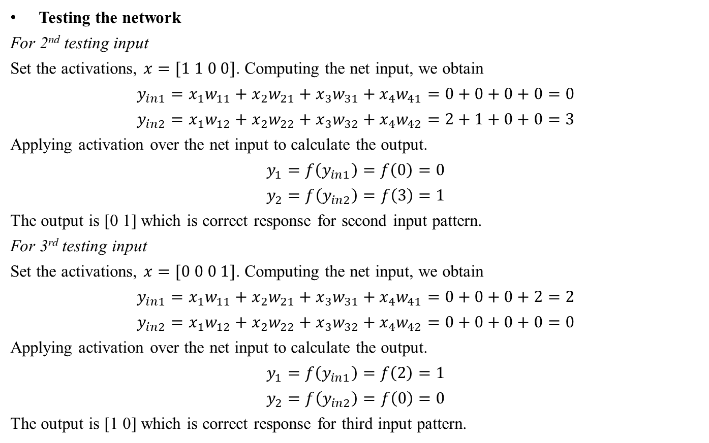
Hetero-associative Memory Network
Testing the network
For 2nd testing input
Set the activations, $x=[1 1 0 0]$. Computing the net input, we obtain
$$y_{in1}=x_{1}w_{11}+x_{2}w_{21}+x_{3}w_{31}+x_{4}w_{41}=0+0+0+0=0$$
$$y_{in2}=x_{1}w_{12}+x_{2}w_{22}+x_{3}w_{32}+x_{4}w_{42}=2+1+0+0=3$$
Applying activation over the net input to calculate the output.
$$y_{1}=f\left(y_{in1}\right)=f\left(0\right)=0$$
$$y_{2}=f\left(y_{in2}\right)=f\left(3\right)=1$$
The output is [0 1] which is correct response for second input pattern.
For 3rd testing input
Set the activations, $x=[0 0 0 1]$. Computing the net input, we obtain
$$y_{in1}=x_{1}w_{11}+x_{2}w_{21}+x_{3}w_{31}+x_{4}w_{41}=0+0+0+2=2$$
$$y_{in2}=x_{1}w_{12}+x_{2}w_{22}+x_{3}w_{32}+x_{4}w_{42}=0+0+0+0=0$$
Applying activation over the net input to calculate the output.
$$y_{1}=f\left(y_{in1}\right)=f\left(2\right)=1$$
$$y_{2}=f\left(y_{in2}\right)=f\left(0\right)=0$$
The output is [1 0] which is correct response for third input pattern.

Slide 44
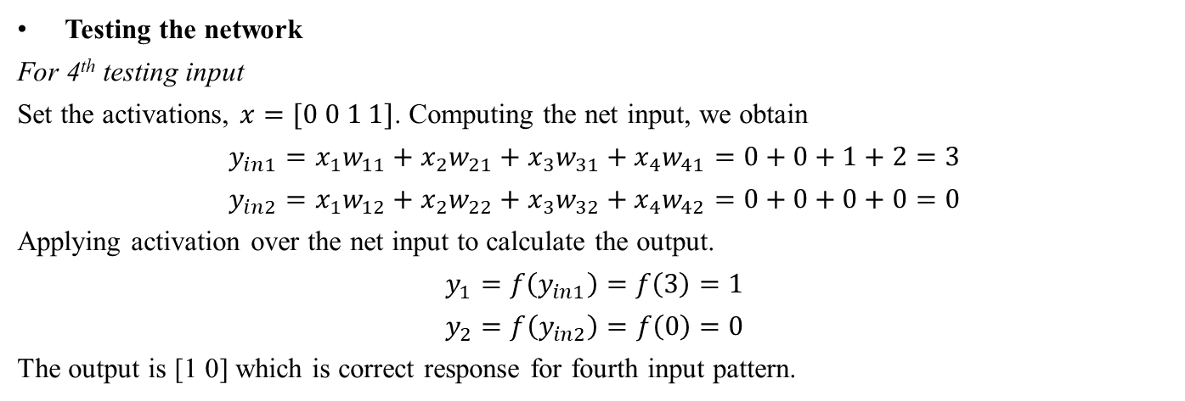
Hetero-associative Memory Network
Testing the network
For 4th testing input
Set the activations, $x=[0 0 1 1]$. Computing the net input, we obtain
$$y_{in1}=x_{1}w_{11}+x_{2}w_{21}+x_{3}w_{31}+x_{4}w_{41}=0+0+1+2=3$$
$$y_{in2}=x_{1}w_{12}+x_{2}w_{22}+x_{3}w_{32}+x_{4}w_{42}=0+0+0+0=0$$
Applying activation over the net input to calculate the output.
$$y_{1}=f\left(y_{in1}\right)=f\left(3\right)=1$$
$$y_{2}=f\left(y_{in2}\right)=f\left(0\right)=0$$
The output is [1 0] which is correct response for fourth input pattern.

Slide 45
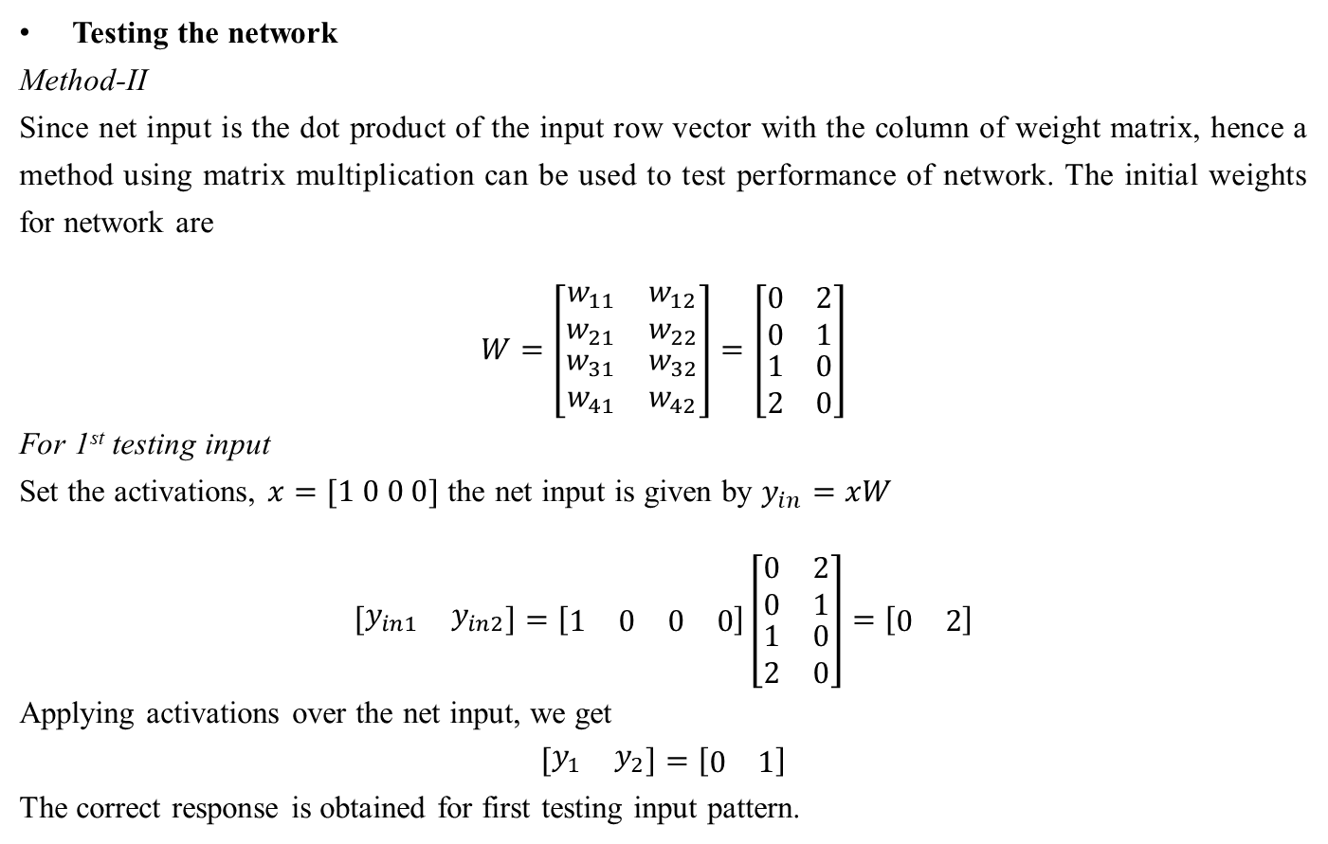
Hetero-associative Memory Network
Testing the network
Method-II
Since net input is the dot product of the input row vector with the column of weight matrix, hence a method using matrix multiplication can be used to test performance of network. The initial weights for network are
$$W=\left[\begin{matrix}\begin{matrix}w_{11} & w_{12} \\ w_{21} & w_{22}\end{matrix} \\ \begin{matrix}w_{31} & w_{32} \\ w_{41} & w_{42}\end{matrix}\end{matrix}\right]=\left[\begin{matrix}\begin{matrix}0 & 2 \\ 0 & 1\end{matrix} \\ \begin{matrix}1 & 0 \\ 2 & 0\end{matrix}\end{matrix}\right]$$
For 1st testing input
Set the activations, $x=[1 0 0 0]$ the net input is given by $y_{in}=xW$
$$\left[\begin{matrix}y_{in1} & y_{in2}\end{matrix}\right]=\left[\begin{matrix}\begin{matrix}1 & 0\end{matrix} & \begin{matrix}0 & 0\end{matrix}\end{matrix}\right]\left[\begin{matrix}\begin{matrix}0 & 2 \\ 0 & 1\end{matrix} \\ \begin{matrix}1 & 0 \\ 2 & 0\end{matrix}\end{matrix}\right]=\left[\begin{matrix}0 & 2\end{matrix}\right]$$
Applying activations over the net input, we get
$$\left[\begin{matrix}y_{1} & y_{2}\end{matrix}\right]=\left[\begin{matrix}0 & 1\end{matrix}\right]$$
The correct response is obtained for first testing input pattern.

Slide 46
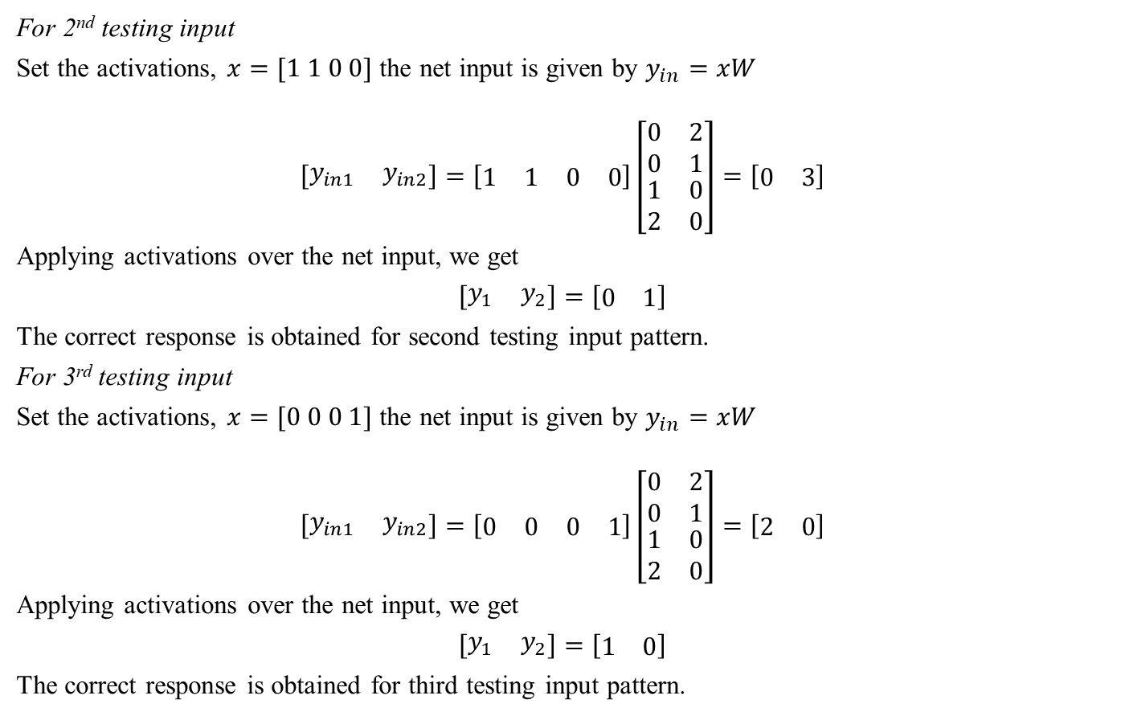
Hetero-associative Memory Network
For 2nd testing input
Set the activations, $x=[1 1 0 0]$ the net input is given by $y_{in}=xW$
$$\left[\begin{matrix}y_{in1} & y_{in2}\end{matrix}\right]=\left[\begin{matrix}\begin{matrix}1 & 1\end{matrix} & \begin{matrix}0 & 0\end{matrix}\end{matrix}\right]\left[\begin{matrix}\begin{matrix}0 & 2 \\ 0 & 1\end{matrix} \\ \begin{matrix}1 & 0 \\ 2 & 0\end{matrix}\end{matrix}\right]=\left[\begin{matrix}0 & 3\end{matrix}\right]$$
Applying activations over the net input, we get
$$\left[\begin{matrix}y_{1} & y_{2}\end{matrix}\right]=\left[\begin{matrix}0 & 1\end{matrix}\right]$$
The correct response is obtained for second testing input pattern.
For 3rd testing input
Set the activations, $x=[0 0 0 1]$ the net input is given by $y_{in}=xW$
$$\left[\begin{matrix}y_{in1} & y_{in2}\end{matrix}\right]=\left[\begin{matrix}\begin{matrix}0 & 0\end{matrix} & \begin{matrix}0 & 1\end{matrix}\end{matrix}\right]\left[\begin{matrix}\begin{matrix}0 & 2 \\ 0 & 1\end{matrix} \\ \begin{matrix}1 & 0 \\ 2 & 0\end{matrix}\end{matrix}\right]=\left[\begin{matrix}2 & 0\end{matrix}\right]$$
Applying activations over the net input, we get
$$\left[\begin{matrix}y_{1} & y_{2}\end{matrix}\right]=\left[\begin{matrix}1 & 0\end{matrix}\right]$$
The correct response is obtained for third testing input pattern.

Slide 47
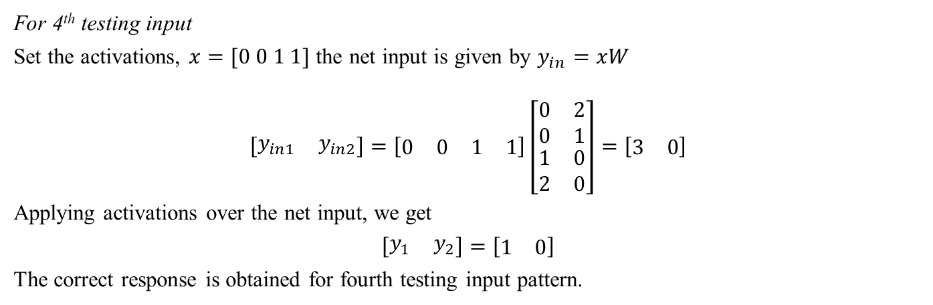
Hetero-associative Memory Network
For 4th testing input
Set the activations, $x=[0 0 1 1]$ the net input is given by $y_{in}=xW$
$$\left[\begin{matrix}y_{in1} & y_{in2}\end{matrix}\right]=\left[\begin{matrix}\begin{matrix}0 & 0\end{matrix} & \begin{matrix}1 & 1\end{matrix}\end{matrix}\right]\left[\begin{matrix}\begin{matrix}0 & 2 \\ 0 & 1\end{matrix} \\ \begin{matrix}1 & 0 \\ 2 & 0\end{matrix}\end{matrix}\right]=\left[\begin{matrix}3 & 0\end{matrix}\right]$$
Applying activations over the net input, we get
$$\left[\begin{matrix}y_{1} & y_{2}\end{matrix}\right]=\left[\begin{matrix}1 & 0\end{matrix}\right]$$
The correct response is obtained for fourth testing input pattern.

Slide 48
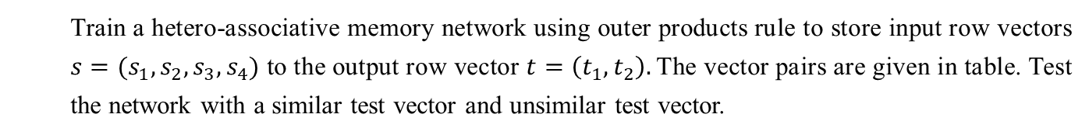
Hetero-associative Memory Network
Train a hetero-associative memory network using outer products rule to store input row vectors $s=(s_{1},s_{2},s_{3},s_{4})$ to the output row vector $t=\left(t_{1},t_{2}\right).$The vector pairs are given in table. Test the network with a similar test vector and unsimilar test vector.
Input Targets | $$s_{1}$$ | $$s_{2}$$ | $$s_{3}$$ | $$s_{4}$$ | $$t_{1}$$ | $$t_{2}$$
1st | 1 | 0 | 0 | 0 | 0 | 1
2nd | 1 | 1 | 0 | 0 | 0 | 1
3rd | 0 | 0 | 0 | 1 | 1 | 0
4th | 0 | 0 | 1 | 1 | 1 | 0

Slide 49
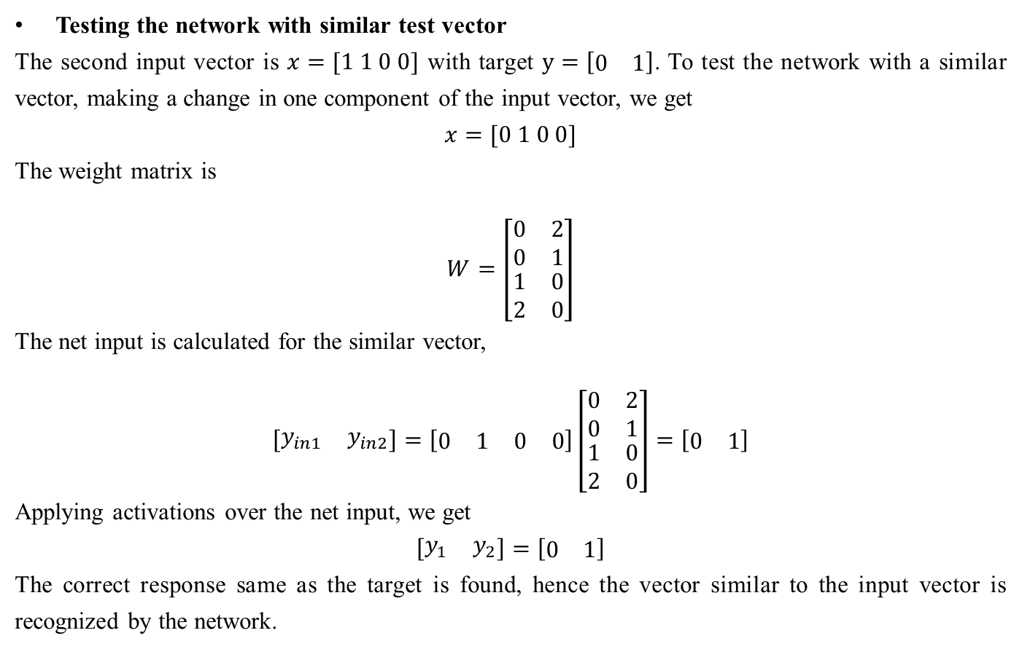
Hetero-associative Memory Network
Testing the network with similar test vector
The second input vector is $x=[1 1 0 0]$ with target $y=\left[\begin{matrix}0 & 1\end{matrix}\right]$. To test the network with a similar vector, making a change in one component of the input vector, we get
$$x=[0 1 0 0]$$
The weight matrix is
$$W=\left[\begin{matrix}\begin{matrix}0 & 2 \\ 0 & 1\end{matrix} \\ \begin{matrix}1 & 0 \\ 2 & 0\end{matrix}\end{matrix}\right]$$
The net input is calculated for the similar vector,
$$\left[\begin{matrix}y_{in1} & y_{in2}\end{matrix}\right]=\left[\begin{matrix}\begin{matrix}0 & 1\end{matrix} & \begin{matrix}0 & 0\end{matrix}\end{matrix}\right]\left[\begin{matrix}\begin{matrix}0 & 2 \\ 0 & 1\end{matrix} \\ \begin{matrix}1 & 0 \\ 2 & 0\end{matrix}\end{matrix}\right]=\left[\begin{matrix}0 & 1\end{matrix}\right]$$
Applying activations over the net input, we get
$$\left[\begin{matrix}y_{1} & y_{2}\end{matrix}\right]=\left[\begin{matrix}0 & 1\end{matrix}\right]$$
The correct response same as the target is found, hence the vector similar to the input vector is recognized by the network.

Slide 50
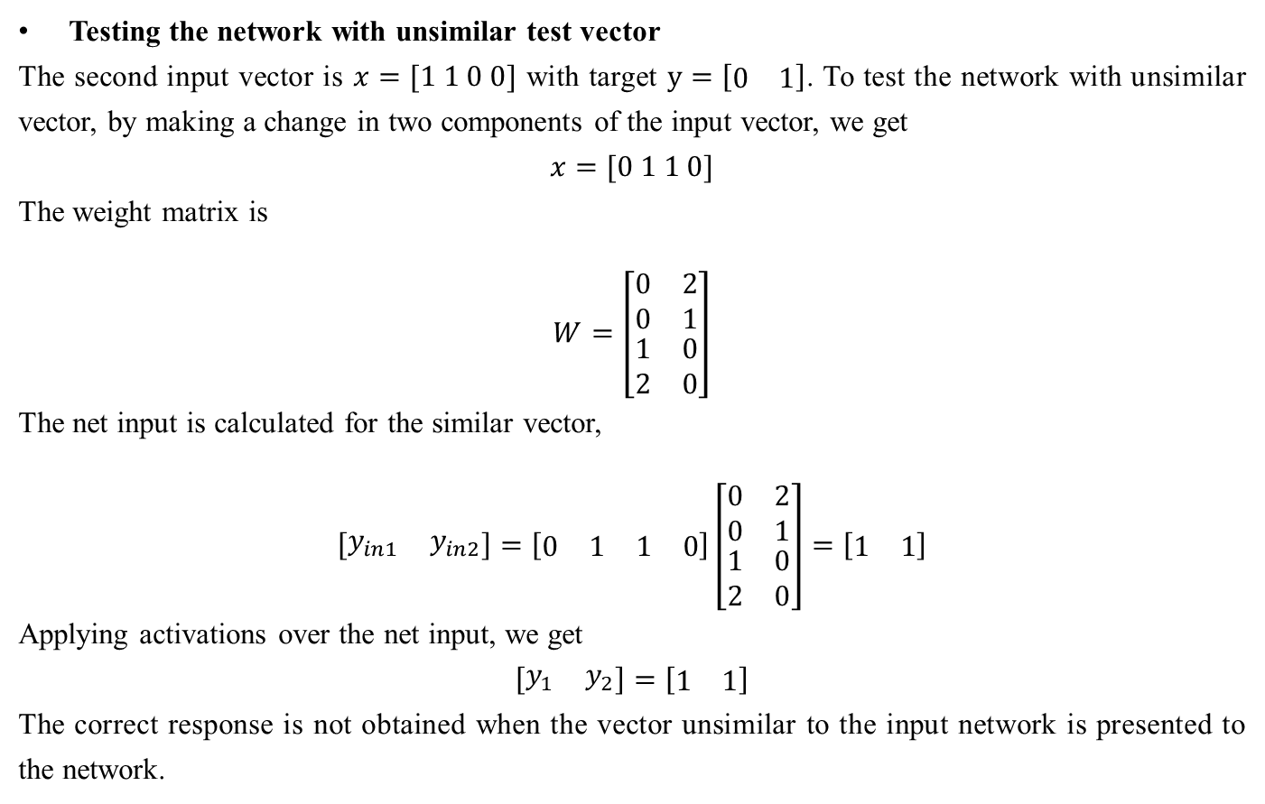
Hetero-associative Memory Network
Testing the network with unsimilar test vector
The second input vector is $x=[1 1 0 0]$ with target $y=\left[\begin{matrix}0 & 1\end{matrix}\right]$. To test the network with unsimilar vector, by making a change in two components of the input vector, we get
$$x=[0 1 1 0]$$
The weight matrix is
$$W=\left[\begin{matrix}\begin{matrix}0 & 2 \\ 0 & 1\end{matrix} \\ \begin{matrix}1 & 0 \\ 2 & 0\end{matrix}\end{matrix}\right]$$
The net input is calculated for the similar vector,
$$\left[\begin{matrix}y_{in1} & y_{in2}\end{matrix}\right]=\left[\begin{matrix}\begin{matrix}0 & 1\end{matrix} & \begin{matrix}1 & 0\end{matrix}\end{matrix}\right]\left[\begin{matrix}\begin{matrix}0 & 2 \\ 0 & 1\end{matrix} \\ \begin{matrix}1 & 0 \\ 2 & 0\end{matrix}\end{matrix}\right]=\left[\begin{matrix}1 & 1\end{matrix}\right]$$
Applying activations over the net input, we get
$$\left[\begin{matrix}y_{1} & y_{2}\end{matrix}\right]=\left[\begin{matrix}1 & 1\end{matrix}\right]$$
The correct response is not obtained when the vector unsimilar to the input network is presented to the network.

Slide 51
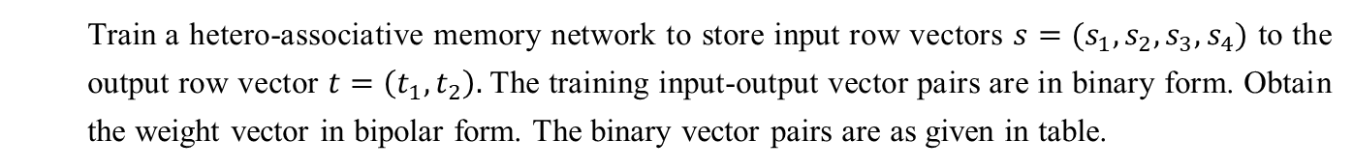
Hetero-associative Memory Network
Train a hetero-associative memory network to store input row vectors $s=(s_{1},s_{2},s_{3},s_{4})$ to the output row vector $t=\left(t_{1},t_{2}\right).$The training input-output vector pairs are in binary form. Obtain the weight vector in bipolar form. The binary vector pairs are as given in table.
Input Targets | $$s_{1}$$ | $$s_{2}$$ | $$s_{3}$$ | $$s_{4}$$ | $$t_{1}$$ | $$t_{2}$$
1st | 1 | 0 | 0 | 0 | 0 | 1
2nd | 1 | 1 | 0 | 0 | 0 | 1
3rd | 0 | 0 | 0 | 1 | 1 | 0
4th | 0 | 0 | 1 | 1 | 1 | 0

Slide 52
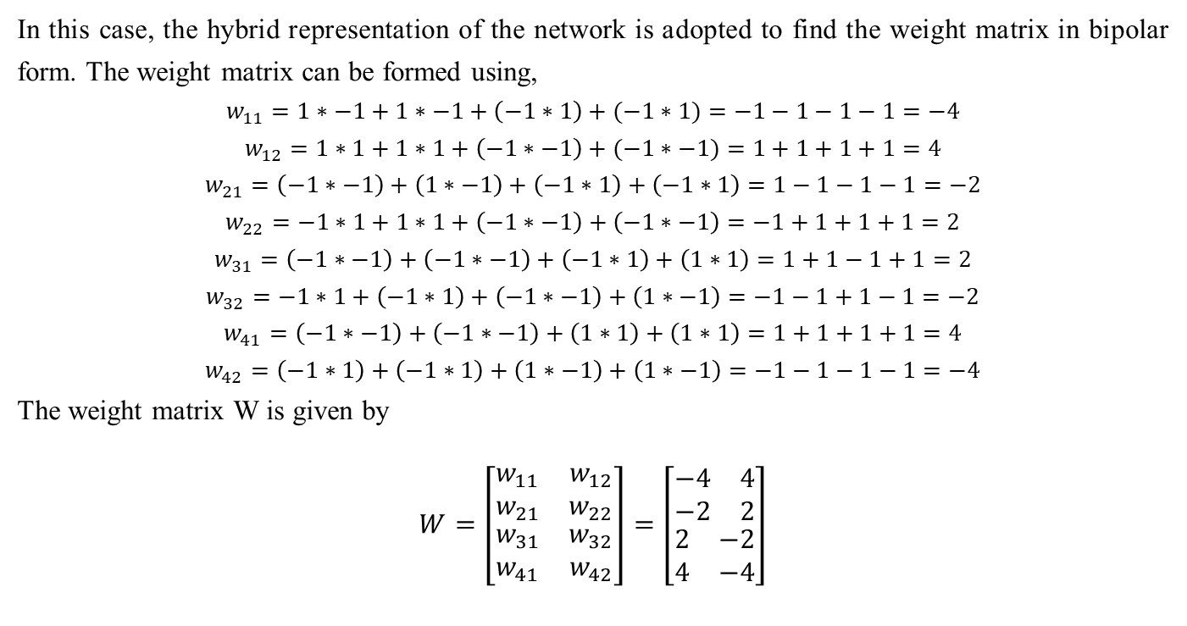
Hetero-associative Memory Network
In this case, the hybrid representation of the network is adopted to find the weight matrix in bipolar form. The weight matrix can be formed using,
$$w_{11}=1∗−1+1∗−1+\left(−1∗1\right)+(−1∗1)=−1−1−1−1=−4$$
$$w_{12}=1∗1+1∗1+\left(−1∗−1\right)+(−1∗−1)=1+1+1+1=4$$
$$w_{21}=\left(−1∗−1\right)+\left(1∗−1\right)+\left(−1∗1\right)+\left(−1∗1\right)=1−1−1−1=−2$$
$$w_{22}=−1∗1+1∗1+\left(−1∗−1\right)+\left(−1∗−1\right)=−1+1+1+1=2$$
$$w_{31}=\left(−1∗−1\right)+\left(−1∗−1\right)+\left(−1∗1\right)+\left(1∗1\right)=1+1−1+1=2$$
$$w_{32}=−1∗1+\left(−1∗1\right)+\left(−1∗−1\right)+\left(1∗−1\right)=−1−1+1−1=−2$$
$$w_{41}=\left(−1∗−1\right)+\left(−1∗−1\right)+\left(1∗1\right)+\left(1∗1\right)=1+1+1+1=4$$
$$w_{42}=\left(−1∗1\right)+\left(−1∗1\right)+\left(1∗−1\right)+\left(1∗−1\right)=−1−1−1−1=−4$$
The weight matrix W is given by
$$W=\left[\begin{matrix}\begin{matrix}w_{11} & w_{12} \\ w_{21} & w_{22}\end{matrix} \\ \begin{matrix}w_{31} & w_{32} \\ w_{41} & w_{42}\end{matrix}\end{matrix}\right]=\left[\begin{matrix}\begin{matrix}−4 & 4 \\ −2 & 2\end{matrix} \\ \begin{matrix}2 & −2 \\ 4 & −4\end{matrix}\end{matrix}\right]$$

Slide 53
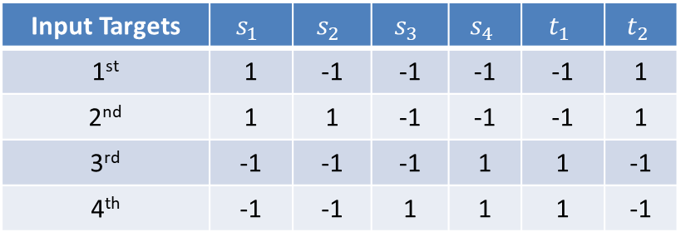
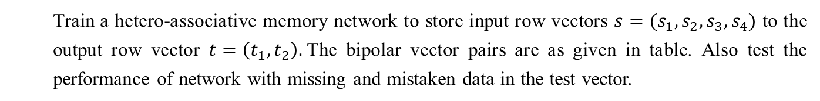
Hetero-associative Memory Network
Train a hetero-associative memory network to store input row vectors $s=(s_{1},s_{2},s_{3},s_{4})$ to the output row vector $t=\left(t_{1},t_{2}\right).$The bipolar vector pairs are as given in table. Also test the performance of network with missing and mistaken data in the test vector.
Input Targets | $$s_{1}$$ | $$s_{2}$$ | $$s_{3}$$ | $$s_{4}$$ | $$t_{1}$$ | $$t_{2}$$
1st | 1 | -1 | -1 | -1 | -1 | 1
2nd | 1 | 1 | -1 | -1 | -1 | 1
3rd | -1 | -1 | -1 | 1 | 1 | -1
4th | -1 | -1 | 1 | 1 | 1 | -1

Slide 54
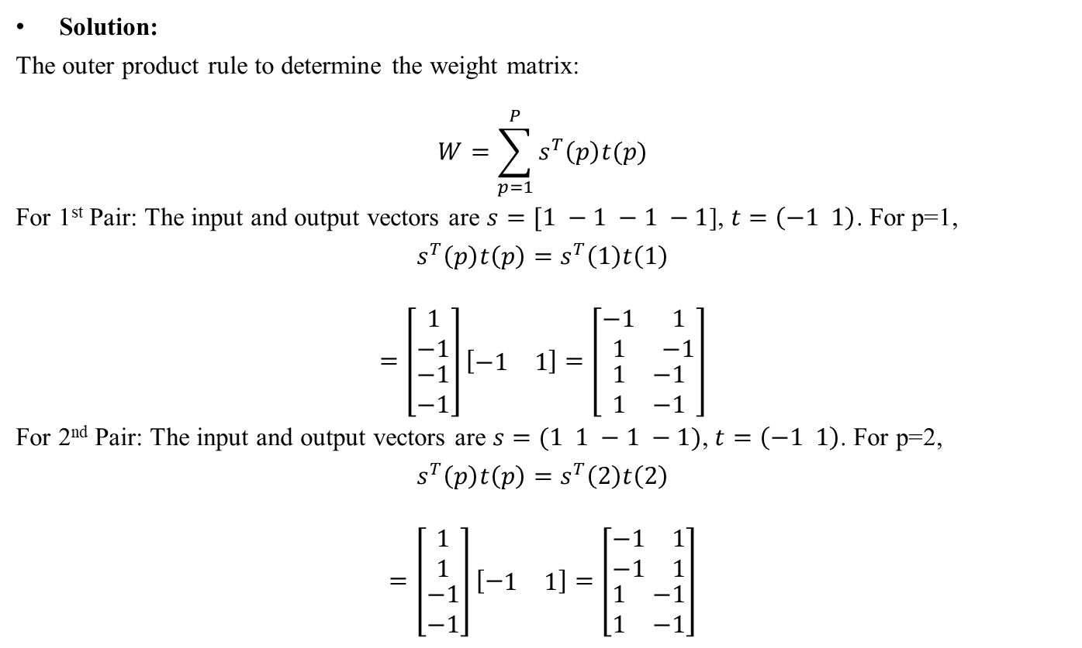
Hetero-associative Memory Network
Solution:
The outer product rule to determine the weight matrix:
$$W=\sum_{p=1}^{P}{s^{T}\left(p\right)t(p)}$$
For 1st Pair: The input and output vectors are $s=[1 −1 −1 −1$], $t=\left(−1 1\right)$. For p=1,
$$s^{T}\left(p\right)t\left(p\right)=s^{T}\left(1\right)t\left(1\right)$$
$$=\left[\begin{matrix}\begin{matrix}1 \\ −1\end{matrix} \\ \begin{matrix}−1 \\ −1\end{matrix}\end{matrix}\right]\left[\begin{matrix}−1 & 1\end{matrix}\right]=\left[\begin{matrix}\begin{matrix}−1 & 1 \\ 1 & −1\end{matrix} \\ \begin{matrix}1 & −1 \\ 1 & −1\end{matrix}\end{matrix}\right]$$
For 2nd Pair: The input and output vectors are $s=(1 1 −1 −1)$, $t=\left(−1 1\right)$. For p=2,
$$s^{T}\left(p\right)t\left(p\right)=s^{T}\left(2\right)t\left(2\right)$$
$$=\left[\begin{matrix}\begin{matrix}1 \\ 1\end{matrix} \\ \begin{matrix}−1 \\ −1\end{matrix}\end{matrix}\right]\left[−\begin{matrix}1 & 1\end{matrix}\right]=\left[\begin{matrix}\begin{matrix}−1 & 1 \\ −1 & 1\end{matrix} \\ \begin{matrix}1 & −1 \\ 1 & −1\end{matrix}\end{matrix}\right]$$

Slide 55

Hetero-associative Memory Network
For 3rd Pair: The input and output vectors are $s=(−1 −1 −1 1)$, $t=\left(1 −1\right)$. For p=3,
$$s^{T}\left(p\right)t\left(p\right)=s^{T}\left(3\right)t\left(3\right)$$
$$=\left[\begin{matrix}\begin{matrix}−1 \\ −1\end{matrix} \\ \begin{matrix}−1 \\ 1\end{matrix}\end{matrix}\right]\left[\begin{matrix}1 & −1\end{matrix}\right]=\left[\begin{matrix}\begin{matrix}−1 & 1 \\ −1 & 1\end{matrix} \\ \begin{matrix}−1 & 1 \\ 1 & −1\end{matrix}\end{matrix}\right]$$
For 4th Pair: The input and output vectors are $s=(−1 −1 1 1)$, $t=\left(1 −1\right)$. For p=4,
$$s^{T}\left(p\right)t\left(p\right)=s^{T}\left(4\right)t\left(4\right)$$
$$=\left[\begin{matrix}\begin{matrix}−1 \\ −1\end{matrix} \\ \begin{matrix}1 \\ 1\end{matrix}\end{matrix}\right]\left[\begin{matrix}1 & −1\end{matrix}\right]=\left[\begin{matrix}\begin{matrix}−1 & 1 \\ −1 & 1\end{matrix} \\ \begin{matrix}1 & −1 \\ 1 & −1\end{matrix}\end{matrix}\right]$$
The final weight matrix is the summation of all the individual weight matrices obtained for each pair.
$$W=\sum_{p=1}^{4}{s^{T}\left(p\right)t(p)}=s^{T}\left(1\right)t\left(1\right)+s^{T}\left(2\right)t\left(2\right)+s^{T}\left(3\right)t\left(3\right)+s^{T}\left(4\right)t\left(4\right)$$
$$W=\left[\begin{matrix}\begin{matrix}−1 & 1 \\ 1 & −1\end{matrix} \\ \begin{matrix}1 & −1 \\ 1 & −1\end{matrix}\end{matrix}\right]+\left[\begin{matrix}\begin{matrix}−1 & 1 \\ −1 & 1\end{matrix} \\ \begin{matrix}1 & −1 \\ 1 & −1\end{matrix}\end{matrix}\right]+\left[\begin{matrix}\begin{matrix}−1 & 1 \\ −1 & 1\end{matrix} \\ \begin{matrix}−1 & 1 \\ 1 & −1\end{matrix}\end{matrix}\right]+\left[\begin{matrix}\begin{matrix}−1 & 1 \\ −1 & 1\end{matrix} \\ \begin{matrix}1 & −1 \\ 1 & −1\end{matrix}\end{matrix}\right]=\left[\begin{matrix}\begin{matrix}−4 & 4 \\ −2 & 2\end{matrix} \\ \begin{matrix}2 & −2 \\ 4 & −4\end{matrix}\end{matrix}\right]$$

Slide 56

Hetero-associative Memory Network
Testing the network with missing data: Let the test vector be $x=\left[0 1 0 −1\right]$ with changes made in two components of second input vector $[1 1 −1 −1]$. Computing the net input, we get,
$$\left[\begin{matrix}y_{in1} & y_{in2}\end{matrix}\right]=\left[\begin{matrix}\begin{matrix}0 & 1\end{matrix} & \begin{matrix}0 & −1\end{matrix}\end{matrix}\right]\left[\begin{matrix}\begin{matrix}−4 & 4 \\ −2 & 2\end{matrix} \\ \begin{matrix}2 & −2 \\ 4 & −4\end{matrix}\end{matrix}\right]=\left[\begin{matrix}−6 & 6\end{matrix}\right]$$
Applying activations over the net input, we get
$$\left[\begin{matrix}y_{1} & y_{2}\end{matrix}\right]=\left[\begin{matrix}−1 & 1\end{matrix}\right]$$
Thus, the net has recognized the missing data.
Testing the network with mistaken data: Let the test vector be $x=\left[−1 1 1 −1\right]$ with changes made in two components of second input vector $[1 1 −1 −1]$. Computing the net input, we get,
$$\left[\begin{matrix}y_{in1} & y_{in2}\end{matrix}\right]=\left[\begin{matrix}\begin{matrix}−1 & 1\end{matrix} & \begin{matrix}1 & −1\end{matrix}\end{matrix}\right]\left[\begin{matrix}\begin{matrix}−4 & 4 \\ −2 & 2\end{matrix} \\ \begin{matrix}2 & −2 \\ 4 & −4\end{matrix}\end{matrix}\right]=\left[\begin{matrix}0 & 0\end{matrix}\right]$$
Applying activations over the net input, we get
$$\left[\begin{matrix}y_{1} & y_{2}\end{matrix}\right]=\left[\begin{matrix}0 & 0\end{matrix}\right]$$
Thus, the net does not recognize the mistaken data because the output obtained [0, 0] has mismatched with the target vector [-1 1].

Slide 57

Continuous BAM
A continuous BAM transforms the input smoothly and continuously in the range 0-1 using logistic sigmoid functions as the activation functions for all units.
The logistic sigmoidal function may be either binary sigmoidal function or bipolar sigmoidal function.
When a bipolar sigmoidal function with a high gain is chosen, then continuous BAM might converge to a state of vectors which will approach vertices of the cube.
When that state of the vector approaches it acts like a discrete BAM.
If the input vectors are binary, (s(p), t(p)), p=1 to P, the weights are determined using the formula
$$w_{ij}=\sum_{p=1}^{P}{\left[2s_{i}\left(p\right)−1\right][2t_{j}\left(p\right)−1]}$$
i.e., even though the input vectors are binary, the weight matrix is bipolar. The activation function used here is the logistic sigmoidal function. If it is binary logistic function, then the activation function is
$$f\left(y_{inj}\right)=\frac{1}{1+e^{−y_{inj}}}$$

Slide 58

Continuous BAM
If the activation function used is a bipolar logistic function, then the function is defined as
$$f\left(y_{inj}\right)=\frac{2}{1+e^{−y_{inj}}}=\frac{1−e^{−y_{inj}}}{1+e^{−y_{inj}}}$$
These activation functions are applied over the net input to calculate the output. The net input can be calculated with a bias included, i.e.,
$$y_{inj}=b_{j}+\sum_{i}{x_{i}w_{ij}}$$
And all these formulas apply for the units in X layer also.

Slide 59

Analysis of Hamming Distance, Energy function and storage capacity
The hamming distance is defined as the number of mismatched components of two given bipolar and binary vectors. It can also be defined as the number of different bits in two binary or bipolar vectors $X$ and $X^{′}.$ It is denoted as $H[X, X^{′}]$.
The average hamming distance between the vectors is $\left(\frac{1}{n}\right)H[X, X^{′}]$, where “n” is the number of components in each vector.
Consider the vectors,
$$X=\left[1 0 1 0 1 1 0\right], X^{′}=[1 1 1 1 0 0 1]$$
The hamming distance between these two given vectors is equal to 5. The average hamming distance between the corresponding vectors is 5/7.
The stability analysis of a BAM is based in the definition of energy function. Consider that there are p vectors association pairs to be stored in a BAM:
$$\left\{\left(x^{1},y^{1}\right),\left(x^{2},y^{2}\right),….,\left(x^{p},y^{p}\right)\right\}$$
Where${ x}^{k}{=(x_{1}^{k},x_{2}^{k},….,x_{n}^{k})}^{T}$ and ${ y}^{k}{=(y_{1}^{k},y_{2}^{k},….,y_{n}^{k})}^{T}$ are either binary or bipolar vectors.
An energy function must be always bounded and decreasing.
A BAM can be said bidirectionally stable if the state converges to a stable point, i.e., $y^{k}→y^{k+1}→y^{k+2}$ and $y^{k+2}=y^{k}$.

Slide 60

Analysis of Hamming Distance, Energy function and storage capacity
This gives the minimum of the energy function. The energy function of a BAM is defined as
$$E_{f}\left(x,y\right)=\frac{−1}{2}x^{T}W^{T}y−\frac{1}{2}y^{T}Wx=−y^{T}Wx$$
The change in energy due to the single bit changes in both vectors y and x given as $∆y_{i}$ and $∆x_{j}$ can be found as
$$∆E_{f}\left(y_{i}\right)=∇_{y}E∆y_{i}=−Wx∆y_{i}=−\left(\sum_{j=1}^{m}{x_{j}w_{ij}}\right)∗∆y_{i}, i=1 to n$$
$$∆E_{f}\left(x_{j}\right)=∇_{x}E∆x_{j}=−W^{T}y∆x_{j}=−\left(\sum_{i=1}^{n}{y_{i}w_{ij}}\right)∗∆x_{j}, j=1 to m$$

Slide 61

Analysis of Hamming Distance, Energy function and storage capacity
Where $∆y_{i}$ and $∆x_{j}$ are given as
$$\begin{matrix}{∆x}_{j}=\left\{\begin{matrix}2 if\sum_{i=1}^{n}{y_{i}w_{ij}}>0 \\ 0 if\sum_{i=1}^{n}{y_{i}w_{ij}}=0 \\ −2 if\sum_{i=1}^{n}{y_{i}w_{ij}}<0\end{matrix}\right. & {∆y}_{i}=\left\{\begin{matrix}2 if\sum_{j=1}^{m}{x_{j}w_{ij}}>0 \\ 0 if\sum_{j=1}^{m}{x_{j}w_{ij}}=0 \\ −2 if\sum_{j=1}^{m}{x_{j}w_{ij}}<00\end{matrix}\right.\end{matrix}$$
Here the energy function is bounded below by
$$E_{f}\left(x,y\right)≥−\sum_{i=1}^{n}{\sum_{j=1}^{m}{\left|w_{ij}\right|}}$$
So the discrete BAM will converge to a stable state.

Slide 62

Analysis of Hamming Distance, Energy function and storage capacity
The memory capacity or the storage capacity of BAM may be given as
$$min⁡(m, n)$$
Where “n” is the number of units in X layer and “m” is the number of units in Y Layer. Also a more conservative capacity is estimated as follows:
$$\sqrt{min⁡(m, n) }$$

Slide 63
Hopfield Networks
John J. Hopfield developed a model in the year 1982 conforming to the asynchronous nature of biological neurons.
The networks proposed by Hopfield are known as Hopfield networks and it is his work that promoted construction of the first analog VLSI neural chip.
This network has found many useful applications in associative memory and various optimization problems.
In this section, two types of network are discussed: discrete and continuous Hopfield networks.

Slide 64

Discrete Hopfield Network
The Hopfield network is an auto-associative fully interconnected single-layer feedback network.
It is also a symmetrically weighted network. When this is operated in discrete line fashion it is called as discrete Hopfield network and its architecture as a single-layer feedback network can be called as recurrent.
The network takes two-valued inputs: binary (0, 1) or bipolar (+l, -1); the use of bipolar inputs makes the analysis easier.
The network has symmetrical weights with no self-connections, i.e.,
$$w_{ij}=w_{ji}; w_{ii}=0$$
The key points to be noted in Hopfield net are: only one unit updates its activation at a time; also each unit is found to continuously receive an external signal along with the signals it receives from the other units in the net.
When a single-layer recurrent network is performing a sequential updating process, an input pattern is first applied to the network and the network's output is found co be initialized accordingly.

Slide 65
Discrete Hopfield Network
Afterwards, the initializing pattern is removed, and the output that is initialized becomes the new updated input through the feedback connections.
The first updated input forces the first updated output, which in turn acts as the second updated input through the feedback interconnections and results in second updated output.
This transition process continues until no new, updated responses are produced and the network reaches its equilibrium.
The asynchronous updation of the units allows a function, called as energy functions or Lyapunov function, for the net.
The existence of this function enables us to prove that the net will converge to a stable set of activations.
The usefulness of content addressable memory is realized by the discrete Hopfield net.

Slide 66

Discrete Hopfield Network (Architecture)

Slide 67

Discrete Hopfield Network (Architecture)
The architecture of discrete Hopfield net is shown in figure. The Hopfield’s model consist of processing elements with two outputs, one inverting and the other non-inverting.
The outputs from each processing element are fed back to the input of other processing elements but not to itself.
The connections are found to be resistive and the connection strength over it is represented as $W_{ij}$.
Here, as such there are no negative resistors, hence excitatory connections use positive outputs and inhibitory connections use inverted outputs.
Connections are excitatory if the output of a processing element is found to be same as the input, and they are inhibitory if the inputs differ from the output of the processing element.
A connection between the processing elements $i$ and $j$ is found to be associated with a connection strength $W_{ij}$·
This weight is positive if units $i$ and $j$are both on. On the ocher hand, if the connection strength is negative, it represents the situation of unit $i$being on and $j$being off.
Also, the weights are symmetric, i.e. the weights $w_{ij}$ are same as $w_{ji}$.

Slide 68

Training algorithm of Discrete Hopfield Net
There exist several versions of the discrete Hopfield net. It should be noted that Hopfield's first description used binary input vectors and only later on bipolar input vectors used.
For storing a set of binary patterns $s(p), p = l to P,$where $s\left(p\right)=(s_{1}\left(p\right),….,s_{i}\left(p\right),…s_{n}(p))$, the weight matrix W is given as
$$w_{ij}=\sum_{p=1}^{P}{\left[2s_{i}\left(p\right)−1\right]\left[2s_{j}\left(p\right)−1\right], for i≠j}$$
For storing a set of bipolar input patterns, $s(p)$(as defined above), the weight matrix W is given as
$$w_{ij}=\sum_{p=1}^{P}{s_{i}\left(p\right)s_{j}\left(p\right) for i≠j}$$
and the weights here have no self-connection, i.e., $w_{ij}$= 0.

Slide 69

Testing algorithm of Discrete Hopfield Net
Step 0: Initialize the weights to store patterns, i.e., weights obtained from training algorithm using Hebb rule.
Step 1: When the activations of the net are not converged, then perform Steps 2-8.
Step 2: Perform Steps 3-7 for each input vector X.
Step 3: Make the initial activations of the net equal to the external input vector X:
$$y_{i}=x_{i} (i=1 to n)$$
Step 4: Perform Steps 5-7 for each unit $Y_{i}$. (Here, the units are updated in random order.)
Step 5: Calculate the net input of the network:
$$y_{ini}=x_{i}+\sum_{j}{y_{j}w_{ji}}$$
Step 6: Apply the activations over the net input to calculate the output:
$$y_{i}=\left\{\begin{matrix}1 if y_{ini}>θ_{i} \\ y_{i} if{ y}_{ini}=θ_{i} \\ o if {y_{ini}<θ}_{i}\end{matrix}\right.$$
where $θ_{i}$ is the threshold and is normally taken as zero.
Step 7: Now feed back (transmit) the obtained output $y_{i}$ to all other units. Thus, the activation vectors are updated.
Step 8: Finally, test the network for convergence.

Slide 70
Discrete Hopfield Network
The updation here is carried out at random, but it should be noted that each unit may be updated at the same average rate.
The asynchronous fashion of updation is carried out here. This means that for a given time only a single neural unit is allowed to update its output.
The next update can be carried out on a randomly chosen node which uses the already updated output.
It can also be said that under asynchronous operation of the network, each output node unit is updated separately by taking into account the most recent values that have already been updated.
This type of updation is referred to as an asynchronous stochastic recursion of the discrete Hopfield network.
By performing the analysis of the Lyapunov function, i.e., the energy function for the Hopfield net, it can be shown that the main feature for the convergence of this net is the asynchronous updation of weights and the weights with no self-connection, i.e., the zeros exist on the diagonals of the weight matrix.

Slide 71
Discrete Hopfield Network
A Hopfield network with binary input vectors is used to determine whether an input vector is a “known” vector or an "unknown" vector.
The net has the capacity to recognize a known vector by producing a pattern of activations on the units of the net that is same as the vector stored in the net.
For example, if the input vector is an unknown vector, the activation vectors resulted during iteration will converge to an activation vector which is not one of the stored patterns; such a pattern is called as spurious stable state.

Slide 72

Analysis of Energy function and storage capacity on Discrete Hopfield Net
An energy function generally is defined as a function that is bounded and is a nonincreasing function of the state of the system.
The energy function, also called as Lyapunov function, determines the stability property of a discrete Hopfield network.
The state of a System for a neural network is the vector of activations of the units.
Hence, if it is possible to find an energy function for an iterative neural net, the net will converge to a stable set of activations.
An energy function $E_{f}$ of a discrete Hopfield network is characterized as
$$E_{f}=−\frac{1}{2}\sum_{i=1}^{n}{\sum_{j=1, j≠i}^{n}{y_{i}y_{j}w_{ij}}}−\sum_{i=1}^{n}{x_{i}y_{i}}+\sum_{i=1}^{n}{θ_{i}y_{i}}$$
If the network is stable, then the above energy function decreases whenever the state of any node changes.

Slide 73

Analysis of Energy function and storage capacity on Discrete Hopfield Net
Assuming that node $i$ has changed its state from $y_{i}^{(k)}$ to $y_{i}^{(k+1)}$, i.e., the output has changed from +1 to -1 or from -1 to +1, the energy change $∆E_{f}$ is then given by
$$∆E_{f}=E_{f}\left(y_{j}^{(k+1)}\right)−E_{f}\left(y_{i}^{\left(k\right)}\right)$$
$$=−\left(\sum_{j=1, j≠i}^{n}{y_{j}^{(k)}w_{ij}}+x_{i}−θ_{i}\right)\left(\left(y_{j}^{(k+1)}\right)−\left(y_{i}^{\left(k\right)}\right)\right)$$
$$=−\left({net}_{i}\right)∆y_{i}$$
Where $∆y_{i}=\left(y_{j}^{(k+1)}\right)−\left(y_{i}^{\left(k\right)}\right)$. The change in energy is dependent on the fact that only one unit can update its activation at a time.
The change in energy equation $∆E_{f}$ exploits the fact that $y_{j}^{(k+1)}=y_{i}^{\left(k\right)}$ for $j≠i$ and $w_{ij}=w_{ji}$ and $w_{ii}=0$ (Symmetric Weight property).

Slide 74

Analysis of Energy function and storage capacity on Discrete Hopfield Net
There exist two cases in which a change $∆y_{i}$ will occur in the activation of neuron $Y_{i}$. If $y_{i}$ is positive, then it will change to zero if
$$\left[x_{i}+\sum_{j=1}^{n}{y_{j}w_{ji}}\right]<θ_{i}$$
This results in a negative change for $y_{i}$ and $∆E_{f}$ < 0. On the other hand, if $y_{i}$ is zero, then it will change to positive if
$$\left[x_{i}+\sum_{j=1}^{n}{y_{j}w_{ji}}\right]>θ_{i}$$
This results in a positive change for $y_{i}$and $∆E_{f}$ < 0. Hence $∆y_{i}$is positive only if net input is positive and $∆y_{i}$ is negative only if net input is negative. Therefore, the energy cannot increase in any manner.
As a result, because the energy is bounded, the net must reach a stable state equilibrium, such that the energy does not change with further iteration. From this it can be concluded that the energy-change depends mainly on the change in activation of one unit and on the symmetry of weight matrix with zeros existing on the diagonal.

Slide 75

Analysis of Energy function and storage capacity on Discrete Hopfield Net
A Hopfield network always converges to a stable state in a finite number of node-updating steps, where every stable state is found to be at the local minima of the energy function $F_{f}.$
Also, the proving process uses the well-known Lyapunov stability theorem, which is generally used to prove the stability of dynamic system defined with arbitrarily many interlocked differential equations.
A positive-definite (energy) function $F_{f}$(y) can be found such that:
$F_{f}$(y) is continuous with respect to all the components $y_{i}$ for $i = 1 to n$;
$\frac{dF_{f}[y\left(t\right)]}{dt}<0$ which indicates that the energy function is decreasing with time and hence the origin of the state space is asymptotically stable.
Hence, a positive-definite (energy) function $F_{f}$(y) satisfying the above requirements can be Lyapunov function for any given system; this function is not unique.

Slide 76

Analysis of Energy function and storage capacity on Discrete Hopfield Net
If, at least one such function can be found for a system, then the system is asymptotically stable.
According to the Lyapunov theorem, the energy function that is associated with a Hopfield network is a Lyapunov function and thus the discrete Hopfield network is asymptotically stable.
The storage capacity is another important factor. It can be found that the number of binary patterns that can be stored and recalled in a network with a reasonable accuracy is given approximately as
$$Storage capacity c≅0.15n$$
where n is the number of neurons in the net. It can also be given as
$$c≅\frac{n}{2\log_{2}{n}}$$

Slide 77
Continuous Hopfield Network
A discrete Hopfield net can be modified to a continuous model, in which time is assumed to be a continuous variable, and can be used for associative memory problems or optimization problems like traveling salesman problem.
The nodes of this network have a continuous, graded output rather than a two-state binary output.
Thus, the energy of the network decreases continuously with time. The continuous Hopfield networks can be realized as an electronic circuit, which uses non-linear amplifiers and resistors.
This helps building the Hopfield network using analog VLSI technology.

Slide 78

Hardware Model of Continuous Hopfield Network
The continuous network build up of electrical components is shown in Figure.
The model consists of n amplifiers, mapping its input voltage $u_{i}$ into an output voltage $y_{i}$ over an activation function a($u_{i}$). The activation function used can be a sigmoid function, say,
$$a\left(λu_{i}\right)=\frac{1}{1+e^{−λu_{i}}}$$
where $λ$ is called the gain parameter.
The continuous model becomes a discrete one when $λ→α$. Each of the amplifiers consists of an input capacitance $c_{i}$ and an input conductance $g_{ri}$. The external signals entering into the circuit are $x_{i}$.
The external signals supply constant current to each amplifier for an actual circuit. The output of the $j^{th}$ node is connected to the input of the $i^{th}$ node through conductance $w_{ij}$.
Since all real resistor values are positive, the inverted node outputs ${\overline{y}}_{i}$ are used to simulate the inhibitory signals.
The connection is made with the signal from the noninverted output if the output of a particular node excites some other node.
If the connection is inhibitory, then the connection is made with the signal from the inverted output.
Here also, the important symmetric weight requirement for Hopfield network is imposed, i.e., $W_{ij}=W_{ji}$ and $W_{ii}=0$.

Slide 79

Hardware Model of Continuous Hopfield Network

Slide 80

Example
Construct an auto-associative discrete Hopfield network with input vector [1 l 1 -1]. Test the discrete Hopfield network with missing entries in first and second components of the stored vector.
Solution:
The input vector is $x=\left[\begin{matrix}\begin{matrix}1 & 1\end{matrix} & \begin{matrix}1 & −1\end{matrix}\end{matrix}\right].$The weight matrix is given by
$$W=\sum_{p=1}^{P}{s^{T}\left(p\right)t(p)}=\left[\begin{matrix}\begin{matrix}1 \\ 1\end{matrix} \\ \begin{matrix}1 \\ −1\end{matrix}\end{matrix}\right]\left[\begin{matrix}\begin{matrix}1 & 1\end{matrix} & \begin{matrix}1 & −1\end{matrix}\end{matrix}\right]=\left[\begin{matrix}\begin{matrix}1 & 1 \\ 1 & 1\end{matrix} & \begin{matrix}1 & −1 \\ 1 & −1\end{matrix} \\ \begin{matrix}1 & 1 \\ −1 & −1\end{matrix} & \begin{matrix}1 & −1 \\ −1 & 1\end{matrix}\end{matrix}\right]$$
The weight matrix with no-self connection is
$$\left[\begin{matrix}\begin{matrix}0 & 1 \\ 1 & 0\end{matrix} & \begin{matrix}1 & −1 \\ 1 & −1\end{matrix} \\ \begin{matrix}1 & 1 \\ −1 & −1\end{matrix} & \begin{matrix}0 & −1 \\ −1 & 0\end{matrix}\end{matrix}\right]$$
The binary representation for the given input vector is $\left[\begin{matrix}\begin{matrix}1 & 1\end{matrix} & \begin{matrix}1 & 0\end{matrix}\end{matrix}\right] .$ We carry out asynchronous updation of weights here. Let it be $Y_{1}, Y_{4},Y_{3}, Y_{2}$.

Slide 81

Example
For the test input vector with two missing entries in first and second components of the stored vector.
Iteration 1:
Step 0: weights are initialize to store the patterns:
$$W=\left[\begin{matrix}\begin{matrix}0 & 1 \\ 1 & 0\end{matrix} & \begin{matrix}1 & −1 \\ 1 & −1\end{matrix} \\ \begin{matrix}1 & 1 \\ −1 & −1\end{matrix} & \begin{matrix}0 & −1 \\ −1 & 0\end{matrix}\end{matrix}\right]$$
Step 1: the input vector is $x=\left[\begin{matrix}\begin{matrix}0 & 0\end{matrix} & \begin{matrix}1 & 0\end{matrix}\end{matrix}\right]$
Step 2: for this vector $y=\left[\begin{matrix}\begin{matrix}0 & 0\end{matrix} & \begin{matrix}1 & 0\end{matrix}\end{matrix}\right]$
Step 3: choose unit $Y_{1}$ for updating its activations:
$$y_{in1}=x_{1}+\sum_{j=1}^{4}{y_{j}w_{j1}}=0+\left[\begin{matrix}\begin{matrix}0 & 0\end{matrix} & \begin{matrix}1 & 0\end{matrix}\end{matrix}\right]\left[\begin{matrix}\begin{matrix}0 \\ 1\end{matrix} \\ \begin{matrix}1 \\ −1\end{matrix}\end{matrix}\right]=0+1=1$$
Applying activations we get $y_{in1}>0→y_{1}=1$. broadcasting $y_{1}$ to all other units, we get
$$y=\left[\begin{matrix}\begin{matrix}1 & 0\end{matrix} & \begin{matrix}1 & 0\end{matrix}\end{matrix}\right]→No convergence$$

Slide 82

Example
Choosing unit $Y_{4}$ for updating its activations:
$$y_{in4}=x_{4}+\sum_{j=1}^{4}{y_{j}w_{j4}}=0+\left[\begin{matrix}\begin{matrix}1 & 0\end{matrix} & \begin{matrix}1 & 0\end{matrix}\end{matrix}\right]\left[\begin{matrix}\begin{matrix}−1 \\ −1\end{matrix} \\ \begin{matrix}−1 \\ 0\end{matrix}\end{matrix}\right]=0−1−1=−2$$
Applying activations we get $y_{in4}<0→y_{4}=0$. broadcasting $y_{4}$ to all other units, we get
$$y=\left[\begin{matrix}\begin{matrix}1 & 0\end{matrix} & \begin{matrix}1 & 0\end{matrix}\end{matrix}\right]→No convergence$$
Choosing unit $Y_{3}$ for updating its activations:
$$y_{in3}=x_{3}+\sum_{j=1}^{4}{y_{j}w_{j3}}=1+\left[\begin{matrix}\begin{matrix}1 & 0\end{matrix} & \begin{matrix}1 & 0\end{matrix}\end{matrix}\right]\left[\begin{matrix}\begin{matrix}1 \\ 1\end{matrix} \\ \begin{matrix}0 \\ −1\end{matrix}\end{matrix}\right]=1+1=2$$
Applying activations we get $y_{in3}>0→y_{3}=1$. broadcasting $y_{3}$ to all other units, we get
$$y=\left[\begin{matrix}\begin{matrix}1 & 0\end{matrix} & \begin{matrix}1 & 0\end{matrix}\end{matrix}\right]→No convergence$$
Choosing unit $Y_{2}$ for updating its activations:
$$y_{in2}=x_{2}+\sum_{j=1}^{4}{y_{j}w_{j2}}=1+\left[\begin{matrix}\begin{matrix}1 & 0\end{matrix} & \begin{matrix}1 & 0\end{matrix}\end{matrix}\right]\left[\begin{matrix}\begin{matrix}1 \\ 0\end{matrix} \\ \begin{matrix}1 \\ −1\end{matrix}\end{matrix}\right]=0+2=2$$
Applying activations we get $y_{in2}>0→y_{2}=1$. broadcasting $y_{2}$ to all other units, we get
$$y=\left[\begin{matrix}\begin{matrix}1 & 1\end{matrix} & \begin{matrix}1 & 0\end{matrix}\end{matrix}\right]→converges with vector x.$$

Slide 83

Example
Thus, the output y has converged with vector x in this iteration itself. But, one more iteration can be done to check whether further activations are there or not. .
Iteration 1:
Step 0: weights are initialize to store the patterns:
$$W=\left[\begin{matrix}\begin{matrix}0 & 1 \\ 1 & 0\end{matrix} & \begin{matrix}1 & −1 \\ 1 & −1\end{matrix} \\ \begin{matrix}1 & 1 \\ −1 & −1\end{matrix} & \begin{matrix}0 & −1 \\ −1 & 0\end{matrix}\end{matrix}\right]$$
Step 1: the input vector is $x=\left[\begin{matrix}\begin{matrix}1 & 1\end{matrix} & \begin{matrix}1 & 0\end{matrix}\end{matrix}\right]$
Step 2: for this vector $y=\left[\begin{matrix}\begin{matrix}1 & 1\end{matrix} & \begin{matrix}1 & 0\end{matrix}\end{matrix}\right]$
Step 3: choose unit $Y_{1}$ for updating its activations:
$$y_{in1}=x_{1}+\sum_{j=1}^{4}{y_{j}w_{j1}}=1+\left[\begin{matrix}\begin{matrix}1 & 1\end{matrix} & \begin{matrix}1 & 0\end{matrix}\end{matrix}\right]\left[\begin{matrix}\begin{matrix}0 \\ 1\end{matrix} \\ \begin{matrix}1 \\ −1\end{matrix}\end{matrix}\right]=3$$
Applying activations we get $y_{in1}>0→y_{1}=1$. broadcasting $y_{1}$ to all other units, we get
$$y=\left[\begin{matrix}\begin{matrix}1 & 1\end{matrix} & \begin{matrix}1 & 0\end{matrix}\end{matrix}\right]$$

Slide 84

Example
Choosing unit $Y_{4}$ for updating its activations:
$$y_{in4}=x_{4}+\sum_{j=1}^{4}{y_{j}w_{j4}}=0+\left[\begin{matrix}\begin{matrix}1 & 1\end{matrix} & \begin{matrix}1 & 0\end{matrix}\end{matrix}\right]\left[\begin{matrix}\begin{matrix}−1 \\ −1\end{matrix} \\ \begin{matrix}−1 \\ 0\end{matrix}\end{matrix}\right]=−3$$
Applying activations we get $y_{in4}<0→y_{4}=0$. broadcasting $y_{4}$ to all other units, we get
$$y=\left[\begin{matrix}\begin{matrix}1 & 1\end{matrix} & \begin{matrix}1 & 0\end{matrix}\end{matrix}\right]$$
Choosing unit $Y_{3}$ for updating its activations:
$$y_{in3}=x_{3}+\sum_{j=1}^{4}{y_{j}w_{j3}}=1+\left[\begin{matrix}\begin{matrix}1 & 1\end{matrix} & \begin{matrix}1 & 0\end{matrix}\end{matrix}\right]\left[\begin{matrix}\begin{matrix}1 \\ 1\end{matrix} \\ \begin{matrix}0 \\ −1\end{matrix}\end{matrix}\right]=3$$
Applying activations we get $y_{in3}>0→y_{3}=1$. broadcasting $y_{3}$ to all other units, we get
$$y=\left[\begin{matrix}\begin{matrix}1 & 1\end{matrix} & \begin{matrix}1 & 0\end{matrix}\end{matrix}\right]$$
Choosing unit $Y_{2}$ for updating its activations:
$$y_{in2}=x_{2}+\sum_{j=1}^{4}{y_{j}w_{j2}}=1+\left[\begin{matrix}\begin{matrix}1 & 1\end{matrix} & \begin{matrix}1 & 0\end{matrix}\end{matrix}\right]\left[\begin{matrix}\begin{matrix}1 \\ 0\end{matrix} \\ \begin{matrix}1 \\ −1\end{matrix}\end{matrix}\right]=3$$
Applying activations we get $y_{in2}>0→y_{2}=1$. broadcasting $y_{2}$ to all other units, we get
$$y=\left[\begin{matrix}\begin{matrix}1 & 1\end{matrix} & \begin{matrix}1 & 0\end{matrix}\end{matrix}\right]$$

Slide 85

Example
Construct an auto-associative network to store the vectors $x_{1}=\left[\begin{matrix}\begin{matrix}\begin{matrix}1 & 1\end{matrix} & 1\end{matrix} & \begin{matrix}1 & 1\end{matrix}\end{matrix}\right]$, $x_{2}=\left[\begin{matrix}\begin{matrix}\begin{matrix}1 & −1\end{matrix} & −1\end{matrix} & \begin{matrix}1 & −1\end{matrix}\end{matrix}\right]$, $x_{3}=\left[\begin{matrix}\begin{matrix}\begin{matrix}−1 & 1\end{matrix} & −1\end{matrix} & \begin{matrix}−1 & −1\end{matrix}\end{matrix}\right]$. Find the weight matrix with no self-connection. Calculate the energy of the stored patterns. Using discrete Hopfield network test patterns if the test patterns are given as $x_{1}=\left[\begin{matrix}\begin{matrix}\begin{matrix}1 & 1\end{matrix} & 1\end{matrix} & \begin{matrix}−1 & 1\end{matrix}\end{matrix}\right]$, $x_{2}=\left[\begin{matrix}\begin{matrix}\begin{matrix}1 & −1\end{matrix} & −1\end{matrix} & \begin{matrix}−1 & −1\end{matrix}\end{matrix}\right]$, $x_{3}=\left[\begin{matrix}\begin{matrix}\begin{matrix}1 & 1\end{matrix} & −1\end{matrix} & \begin{matrix}−1 & −1\end{matrix}\end{matrix}\right]$. Compare the test pattern energy with stored patterns energy.
Solution:
The weight matrix is given by
$$W=\sum_{p=1}^{P}{s^{T}\left(p\right)t(p)}=\left[\begin{matrix}\begin{matrix}1 \\ 1\end{matrix} \\ \begin{matrix}1 \\ \begin{matrix}1 \\ 1\end{matrix}\end{matrix}\end{matrix}\right]\left[\begin{matrix}\begin{matrix}1 & 1\end{matrix} & \begin{matrix}1 & \begin{matrix}1 & 1\end{matrix}\end{matrix}\end{matrix}\right]+\left[\begin{matrix}\begin{matrix}1 \\ −1\end{matrix} \\ \begin{matrix}−1 \\ \begin{matrix}1 \\ −1\end{matrix}\end{matrix}\end{matrix}\right]\left[\begin{matrix}\begin{matrix}1 & −1\end{matrix} & −\begin{matrix}1 & \begin{matrix}1 & −1\end{matrix}\end{matrix}\end{matrix}\right]+\left[\begin{matrix}\begin{matrix}−1 \\ 1\end{matrix} \\ \begin{matrix}−1 \\ \begin{matrix}−1 \\ −1\end{matrix}\end{matrix}\end{matrix}\right]\left[−\begin{matrix}\begin{matrix}1 & 1\end{matrix} & −\begin{matrix}1 & \begin{matrix}−1 & −1\end{matrix}\end{matrix}\end{matrix}\right]=\left[\begin{matrix}\begin{matrix}1 & 1 \\ 1 & 1\end{matrix} & \begin{matrix}1 & \begin{matrix}1 & 1\end{matrix} \\ 1 & \begin{matrix}1 & 1\end{matrix}\end{matrix} \\ \begin{matrix}1 & 1 \\ \begin{matrix}1 \\ 1\end{matrix} & \begin{matrix}1 \\ 1\end{matrix}\end{matrix} & \begin{matrix}1 & \begin{matrix}1 & 1\end{matrix} \\ \begin{matrix}1 \\ 1\end{matrix} & \begin{matrix}\begin{matrix}1 & 1\end{matrix} \\ \begin{matrix}1 & 1\end{matrix}\end{matrix}\end{matrix}\end{matrix}\right]+\left[\begin{matrix}\begin{matrix}1 & −1 \\ −1 & 1\end{matrix} & \begin{matrix}−1 & \begin{matrix}1 & −1\end{matrix} \\ 1 & −\begin{matrix}1 & 1\end{matrix}\end{matrix} \\ \begin{matrix}−1 & 1 \\ \begin{matrix}1 \\ −1\end{matrix} & \begin{matrix}−1 \\ 1\end{matrix}\end{matrix} & \begin{matrix}1 & \begin{matrix}−1 & 1\end{matrix} \\ \begin{matrix}−1 \\ 1\end{matrix} & \begin{matrix}\begin{matrix}1 & −1\end{matrix} \\ \begin{matrix}−1 & 1\end{matrix}\end{matrix}\end{matrix}\end{matrix}\right]+\left[\begin{matrix}\begin{matrix}1 & −1 \\ −1 & 1\end{matrix} & \begin{matrix}1 & \begin{matrix}1 & 1\end{matrix} \\ −1 & \begin{matrix}−1 & −1\end{matrix}\end{matrix} \\ \begin{matrix}1 & −1 \\ \begin{matrix}1 \\ 1\end{matrix} & \begin{matrix}−1 \\ −1\end{matrix}\end{matrix} & \begin{matrix}1 & \begin{matrix}1 & 1\end{matrix} \\ \begin{matrix}1 \\ 1\end{matrix} & \begin{matrix}\begin{matrix}1 & 1\end{matrix} \\ \begin{matrix}1 & 1\end{matrix}\end{matrix}\end{matrix}\end{matrix}\right]=\left[\begin{matrix}\begin{matrix}3 & −1 \\ −1 & 3\end{matrix} & \begin{matrix}1 & \begin{matrix}1 & 1\end{matrix} \\ 1 & −\begin{matrix}1 & 1\end{matrix}\end{matrix} \\ \begin{matrix}1 & 1 \\ \begin{matrix}3 \\ 1\end{matrix} & \begin{matrix}−1 \\ 1\end{matrix}\end{matrix} & \begin{matrix}3 & \begin{matrix}1 & 3\end{matrix} \\ \begin{matrix}1 \\ 3\end{matrix} & \begin{matrix}\begin{matrix}3 & 1\end{matrix} \\ \begin{matrix}1 & 3\end{matrix}\end{matrix}\end{matrix}\end{matrix}\right]$$

Slide 86

Example
The weight matrix with no self connection is
$$\left[\begin{matrix}\begin{matrix}0 & −1 \\ −1 & 0\end{matrix} & \begin{matrix}1 & \begin{matrix}1 & 1\end{matrix} \\ 1 & −\begin{matrix}1 & 1\end{matrix}\end{matrix} \\ \begin{matrix}1 & 1 \\ \begin{matrix}3 \\ 1\end{matrix} & \begin{matrix}−1 \\ 1\end{matrix}\end{matrix} & \begin{matrix}0 & \begin{matrix}1 & 3\end{matrix} \\ \begin{matrix}1 \\ 3\end{matrix} & \begin{matrix}\begin{matrix}0 & 1\end{matrix} \\ \begin{matrix}1 & 0\end{matrix}\end{matrix}\end{matrix}\end{matrix}\right]$$
The energy function is defined as
$$E=−0.5\left[xW^{T}x^{T}\right]$$
Therefore the energy for the $ith$ pattern is given by
$$E=−0.5\left[x_{i}W^{T}x_{i}^{T}\right]$$
Energy for first pattern
$$E_{1}=−0.5\left[x_{1}W^{T}x_{1}^{T}\right]=−0.5∗\left[\begin{matrix}\begin{matrix}\begin{matrix}1 & 1\end{matrix} & 1\end{matrix} & \begin{matrix}1 & 1\end{matrix}\end{matrix}\right]∗\left[\begin{matrix}\begin{matrix}0 & −1 \\ −1 & 0\end{matrix} & \begin{matrix}1 & \begin{matrix}1 & 1\end{matrix} \\ 1 & −\begin{matrix}1 & 1\end{matrix}\end{matrix} \\ \begin{matrix}1 & 1 \\ \begin{matrix}3 \\ 1\end{matrix} & \begin{matrix}−1 \\ 1\end{matrix}\end{matrix} & \begin{matrix}0 & \begin{matrix}1 & 3\end{matrix} \\ \begin{matrix}1 \\ 3\end{matrix} & \begin{matrix}\begin{matrix}0 & 1\end{matrix} \\ \begin{matrix}1 & 0\end{matrix}\end{matrix}\end{matrix}\end{matrix}\right]∗\left[\begin{matrix}\begin{matrix}1 \\ 1\end{matrix} \\ \begin{matrix}1 \\ \begin{matrix}1 \\ 1\end{matrix}\end{matrix}\end{matrix}\right]$$
$$=−0.5∗\left[\begin{matrix}\begin{matrix}\begin{matrix}1 & 1\end{matrix} & 1\end{matrix} & \begin{matrix}1 & 1\end{matrix}\end{matrix}\right]∗\left[\begin{matrix}\begin{matrix}4 \\ 0\end{matrix} \\ \begin{matrix}6 \\ \begin{matrix}4 \\ 6\end{matrix}\end{matrix}\end{matrix}\right]=−0.5\left[4+0+6+4+6\right]=−0.5\left[20\right]=−10$$

Slide 87

Example
Energy for Second pattern
$$E_{2}=−0.5\left[x_{2}W^{T}x_{2}^{T}\right]=−0.5∗\left[\begin{matrix}\begin{matrix}1 & −1\end{matrix} & −\begin{matrix}1 & \begin{matrix}1 & −1\end{matrix}\end{matrix}\end{matrix}\right]∗\left[\begin{matrix}\begin{matrix}0 & −1 \\ −1 & 0\end{matrix} & \begin{matrix}1 & \begin{matrix}1 & 1\end{matrix} \\ 1 & −\begin{matrix}1 & 1\end{matrix}\end{matrix} \\ \begin{matrix}1 & 1 \\ \begin{matrix}3 \\ 1\end{matrix} & \begin{matrix}−1 \\ 1\end{matrix}\end{matrix} & \begin{matrix}0 & \begin{matrix}1 & 3\end{matrix} \\ \begin{matrix}1 \\ 3\end{matrix} & \begin{matrix}\begin{matrix}0 & 1\end{matrix} \\ \begin{matrix}1 & 0\end{matrix}\end{matrix}\end{matrix}\end{matrix}\right]∗\left[\begin{matrix}\begin{matrix}1 \\ −1\end{matrix} \\ \begin{matrix}−1 \\ \begin{matrix}1 \\ −1\end{matrix}\end{matrix}\end{matrix}\right]$$
$$=−0.5∗\left[\begin{matrix}\begin{matrix}1 & −1\end{matrix} & −\begin{matrix}1 & \begin{matrix}1 & −1\end{matrix}\end{matrix}\end{matrix}\right]∗\left[\begin{matrix}\begin{matrix}2 \\ −4\end{matrix} \\ \begin{matrix}−2 \\ \begin{matrix}2 \\ −2\end{matrix}\end{matrix}\end{matrix}\right]=−0.5\left[2+4+2+2+2\right]=−0.5\left[12\right]=−6$$
Energy for Second pattern
$$E_{3}=−0.5\left[x_{3}W^{T}x_{3}^{T}\right]=−0.5∗\left[−\begin{matrix}\begin{matrix}1 & 1\end{matrix} & −\begin{matrix}1 & \begin{matrix}−1 & −1\end{matrix}\end{matrix}\end{matrix}\right]∗\left[\begin{matrix}\begin{matrix}0 & −1 \\ −1 & 0\end{matrix} & \begin{matrix}1 & \begin{matrix}1 & 1\end{matrix} \\ 1 & −\begin{matrix}1 & 1\end{matrix}\end{matrix} \\ \begin{matrix}1 & 1 \\ \begin{matrix}3 \\ 1\end{matrix} & \begin{matrix}−1 \\ 1\end{matrix}\end{matrix} & \begin{matrix}0 & \begin{matrix}1 & 3\end{matrix} \\ \begin{matrix}1 \\ 3\end{matrix} & \begin{matrix}\begin{matrix}0 & 1\end{matrix} \\ \begin{matrix}1 & 0\end{matrix}\end{matrix}\end{matrix}\end{matrix}\right]∗\left[\begin{matrix}\begin{matrix}−1 \\ 1\end{matrix} \\ \begin{matrix}−1 \\ \begin{matrix}−1 \\ −1\end{matrix}\end{matrix}\end{matrix}\right]$$
$$=−0.5∗\left[−\begin{matrix}\begin{matrix}1 & 1\end{matrix} & −\begin{matrix}1 & \begin{matrix}−1 & −1\end{matrix}\end{matrix}\end{matrix}\right]∗\left[\begin{matrix}\begin{matrix}−6 \\ 0\end{matrix} \\ \begin{matrix}−4 \\ \begin{matrix}−6 \\ −4\end{matrix}\end{matrix}\end{matrix}\right]=−0.5\left[6+0+4+6+4\right]=−0.5\left[20\right]=−10$$

Slide 88

Example
Applying test patterns
For first test pattern $x_{1}^{′}=\left[\begin{matrix}\begin{matrix}\begin{matrix}1 & 1\end{matrix} & 1\end{matrix} & \begin{matrix}−1 & 1\end{matrix}\end{matrix}\right]$ and $y=\left[\begin{matrix}\begin{matrix}\begin{matrix}1 & 1\end{matrix} & 1\end{matrix} & \begin{matrix}−1 & 1\end{matrix}\end{matrix}\right]$. Choosing unit 4 for updation, we get
$$y_{in4}=x_{4}+\sum_{j=1}^{4}{y_{j}w_{j4}}=−1+\left[\begin{matrix}\begin{matrix}\begin{matrix}1 & 1\end{matrix} & 1\end{matrix} & \begin{matrix}−1 & 1\end{matrix}\end{matrix}\right]\left[\begin{matrix}\begin{matrix}3 \\ −1\end{matrix} \\ \begin{matrix}1 \\ \begin{matrix}0 \\ 1\end{matrix}\end{matrix}\end{matrix}\right]=−1+3−1+1−0+1=3$$
Applying activations, we get $y_{4}=1. therefore,x_{1}^{′}=\left[\begin{matrix}\begin{matrix}\begin{matrix}1 & 1\end{matrix} & 1\end{matrix} & \begin{matrix}1 & 1\end{matrix}\end{matrix}\right]$. The energy function is given by
$$E_{1}^{′}=−0.5\left[x_{1}^{′}W^{T}{x_{1}^{′}}^{T}\right]$$
On substituting corresponding values, we get
$$E_{1}^{′}=−10$$
For second test pattern $x_{1}^{′}=\left[\begin{matrix}\begin{matrix}\begin{matrix}1 & −1\end{matrix} & −1\end{matrix} & \begin{matrix}−1 & −1\end{matrix}\end{matrix}\right]$ and $y=\left[\begin{matrix}\begin{matrix}\begin{matrix}1 & −1\end{matrix} & −1\end{matrix} & \begin{matrix}−1 & −1\end{matrix}\end{matrix}\right]$. Choosing unit 4 for updation, we get
$$y_{in4}=x_{4}+\sum_{j=1}^{4}{y_{j}w_{j4}}=−1+\left[\begin{matrix}\begin{matrix}\begin{matrix}1 & −1\end{matrix} & −1\end{matrix} & \begin{matrix}−1 & −1\end{matrix}\end{matrix}\right]\left[\begin{matrix}\begin{matrix}3 \\ −1\end{matrix} \\ \begin{matrix}1 \\ \begin{matrix}0 \\ 1\end{matrix}\end{matrix}\end{matrix}\right]=−1+3+1−1−0−1=1$$
Applying activations, we get $y_{4}=1. therefore,x_{2}^{′}=\left[\begin{matrix}\begin{matrix}\begin{matrix}1 & −1\end{matrix} & −1\end{matrix} & \begin{matrix}1 & −1\end{matrix}\end{matrix}\right]$. The energy function is given by
$$E_{2}^{′}=−0.5\left[x_{2}^{′}W^{T}{x_{2}^{′}}^{T}\right]$$

Slide 89

Example
$$E_{2}^{′}=−0.5\left[x_{2}^{′}W^{T}{x_{2}^{′}}^{T}\right]$$
$$=−0.5\left[\begin{matrix}\begin{matrix}\begin{matrix}1 & −1\end{matrix} & −1\end{matrix} & \begin{matrix}1 & −1\end{matrix}\end{matrix}\right]W^{T}\left[\begin{matrix}\begin{matrix}1 \\ −1\end{matrix} \\ \begin{matrix}−1 \\ \begin{matrix}1 \\ −1\end{matrix}\end{matrix}\end{matrix}\right]=−0.5\left[12\right]=−6$$
For third test pattern $x_{3}^{′}=\left[\begin{matrix}\begin{matrix}\begin{matrix}1 & 1\end{matrix} & −1\end{matrix} & \begin{matrix}−1 & −1\end{matrix}\end{matrix}\right]$ and $y=\left[\begin{matrix}\begin{matrix}\begin{matrix}1 & 1\end{matrix} & −1\end{matrix} & \begin{matrix}−1 & −1\end{matrix}\end{matrix}\right]$. Choosing unit 1 for updation, we get
$$y_{in1}=x_{1}+\sum_{j=1}^{4}{y_{j}w_{j1}}=1+\left[\begin{matrix}\begin{matrix}\begin{matrix}1 & 1\end{matrix} & −1\end{matrix} & \begin{matrix}−1 & −1\end{matrix}\end{matrix}\right]\left[\begin{matrix}\begin{matrix}0 \\ −1\end{matrix} \\ \begin{matrix}1 \\ \begin{matrix}3 \\ 1\end{matrix}\end{matrix}\end{matrix}\right]=1+0−1−1−3−1=−5$$
Applying activations, we get $y_{1}=−1. therefore,x_{3}^{′}=\left[−\begin{matrix}\begin{matrix}\begin{matrix}1 & 1\end{matrix} & −1\end{matrix} & −\begin{matrix}1 & −1\end{matrix}\end{matrix}\right]$. The energy function is given by
$$E_{2}^{′}=−0.5\left[x_{3}^{′}W^{T}{x_{3}^{′}}^{T}\right]$$
$$=−0.5\left[\begin{matrix}\begin{matrix}\begin{matrix}−1 & 1\end{matrix} & −1\end{matrix} & −\begin{matrix}1 & −1\end{matrix}\end{matrix}\right]W^{T}\left[\begin{matrix}\begin{matrix}−1 \\ 1\end{matrix} \\ \begin{matrix}−1 \\ \begin{matrix}−1 \\ −1\end{matrix}\end{matrix}\end{matrix}\right]=−0.5\left[20\right]=−10$$
Thus the energy of the stored pattern is same as that of the test pattern.

